Slide 1
Ad fontem in Crucem
The formative function of the cross as artistic and ritual sign

Slide 2
Inscribing the cross as a way of life
Ritual and the Senses

Slide 3
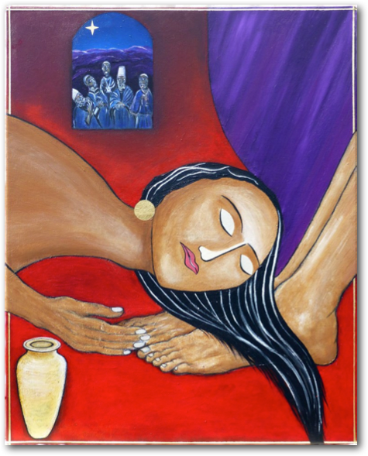

Slide 4
The cross as formative symbol

Slide 5
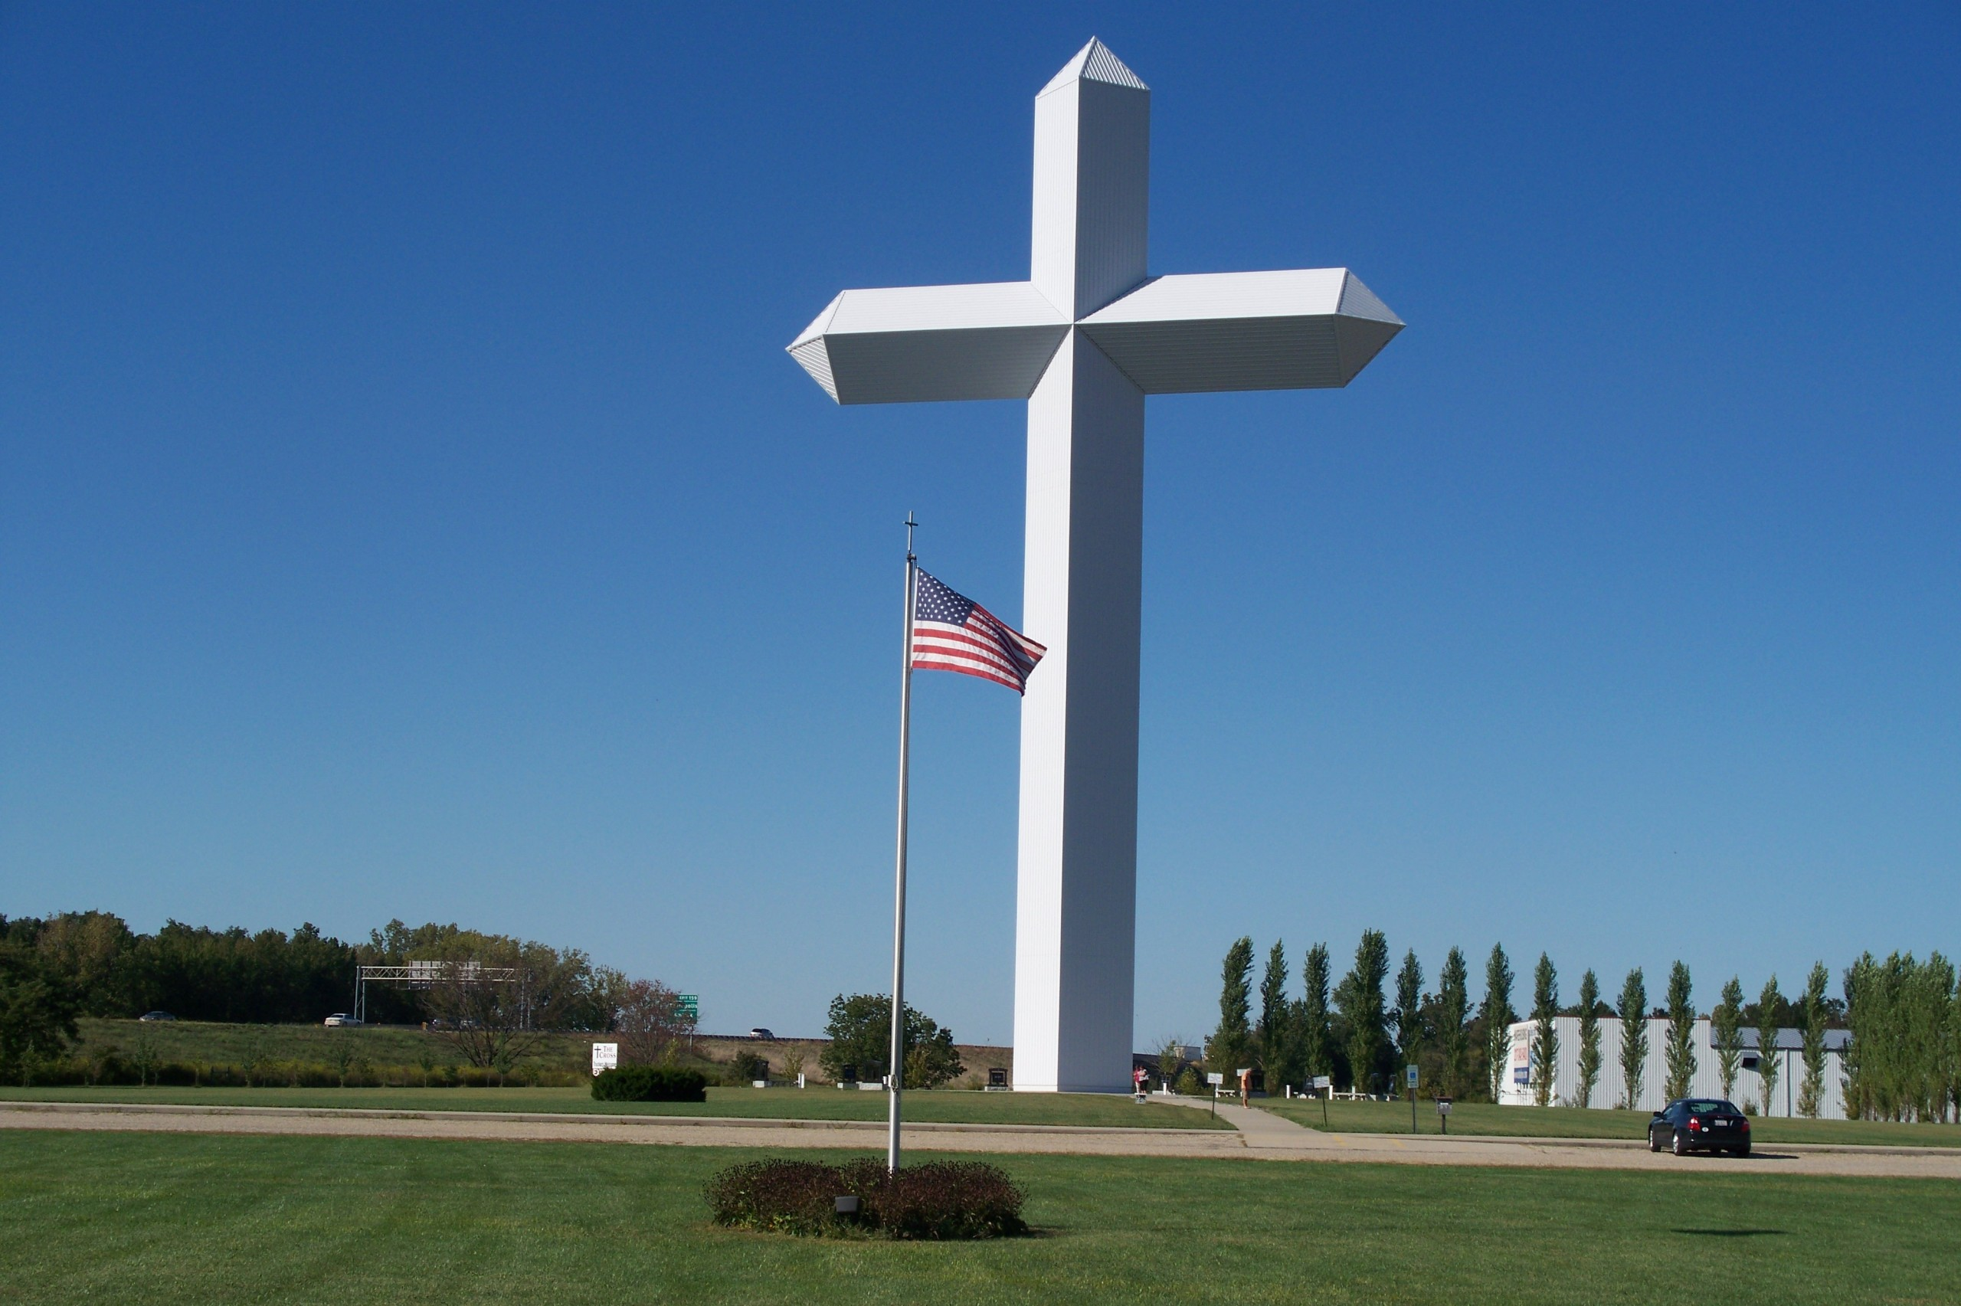

Slide 6
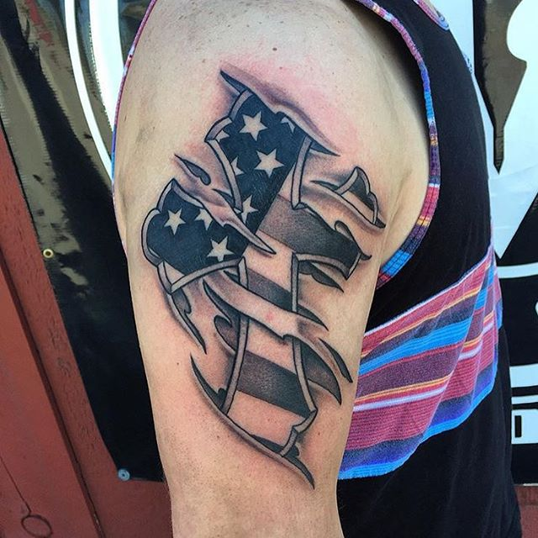

Slide 7
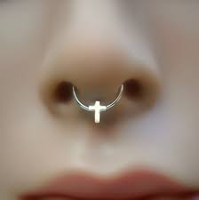

Slide 8
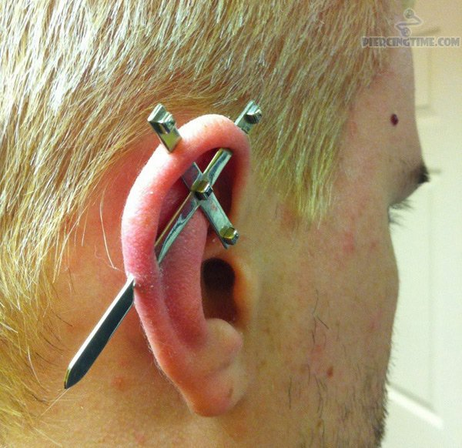

Slide 9
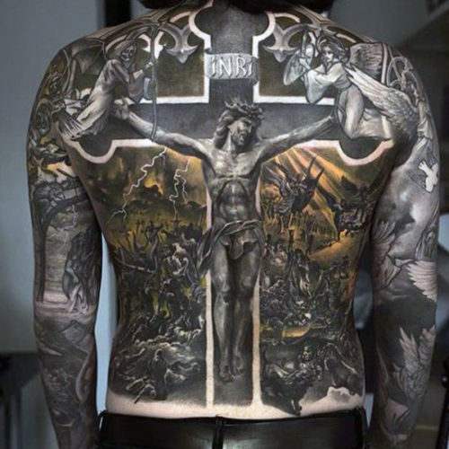

Slide 10
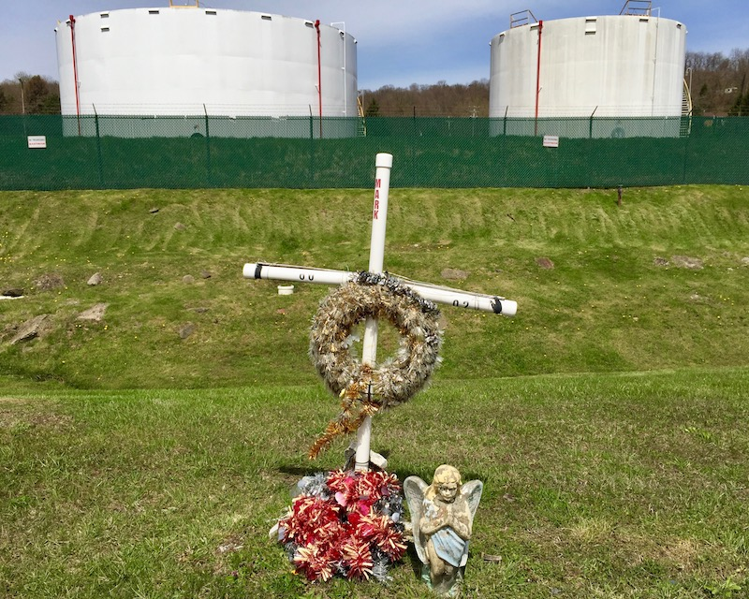

Slide 11
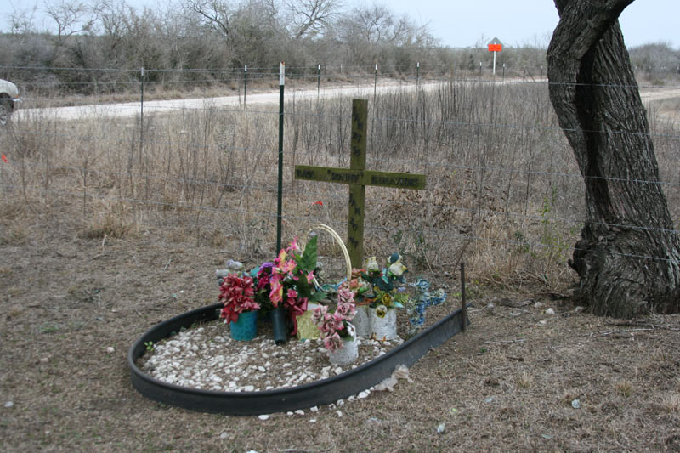

Slide 12
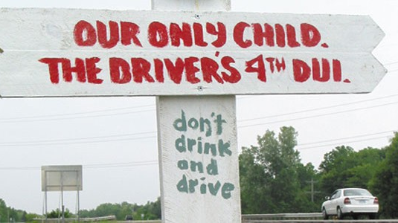

Slide 13
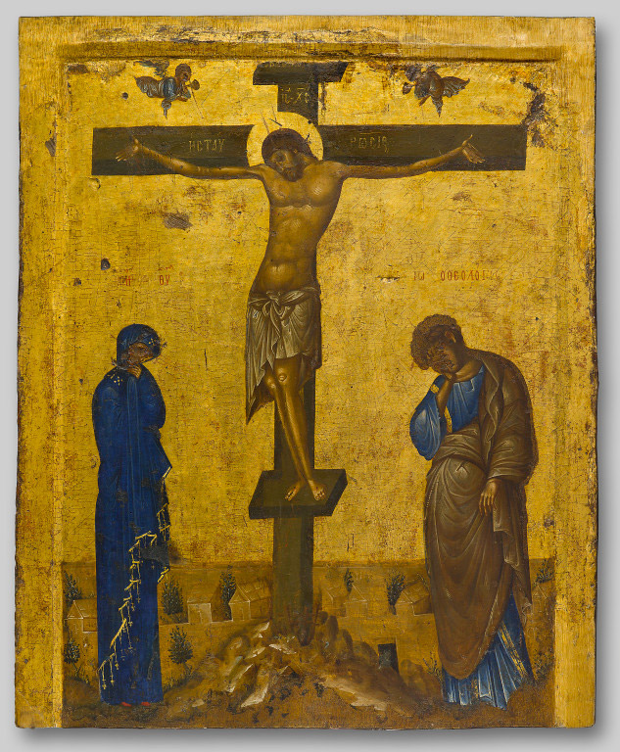

Slide 14
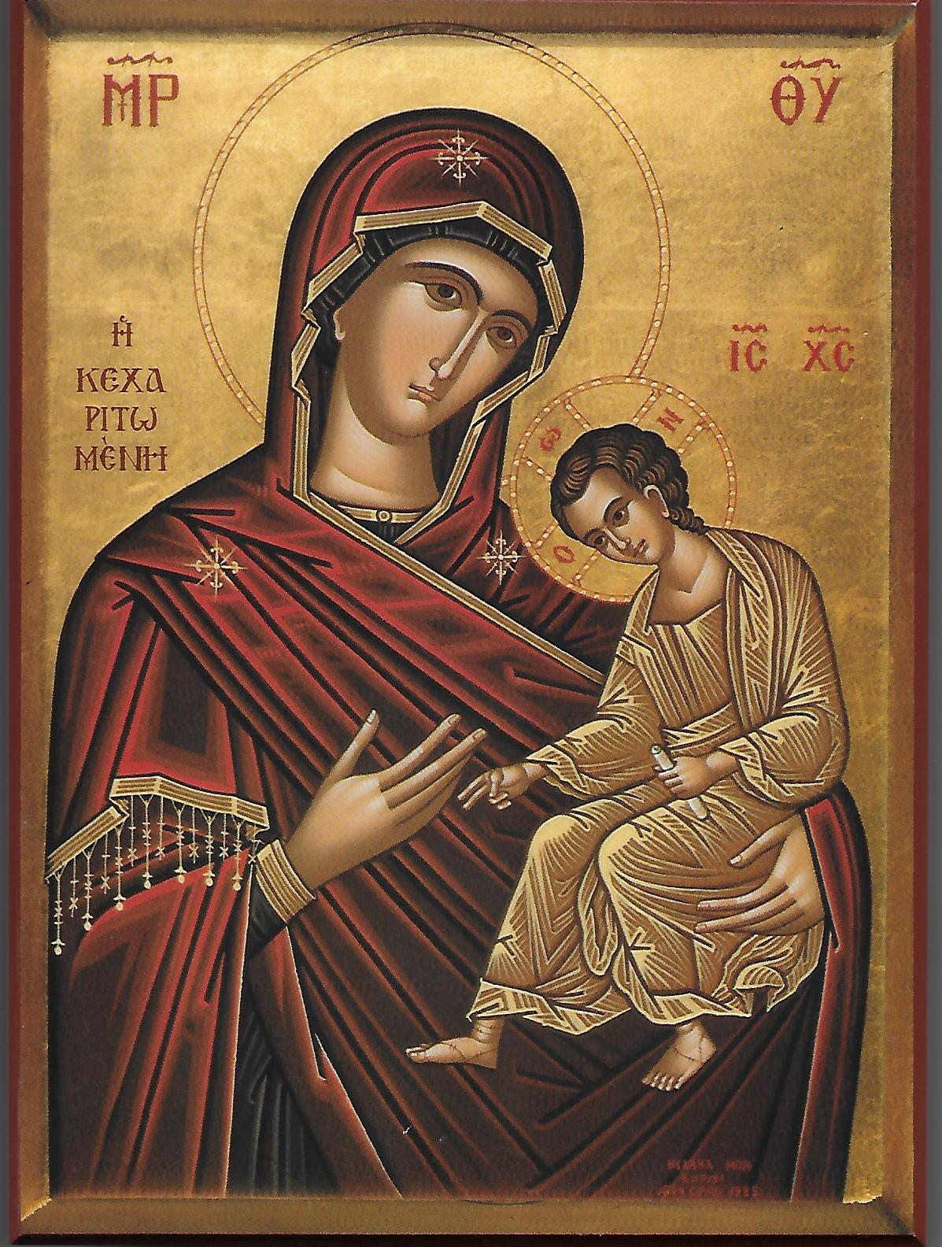
Sample Footer Text
10/8/2018
14

Slide 15
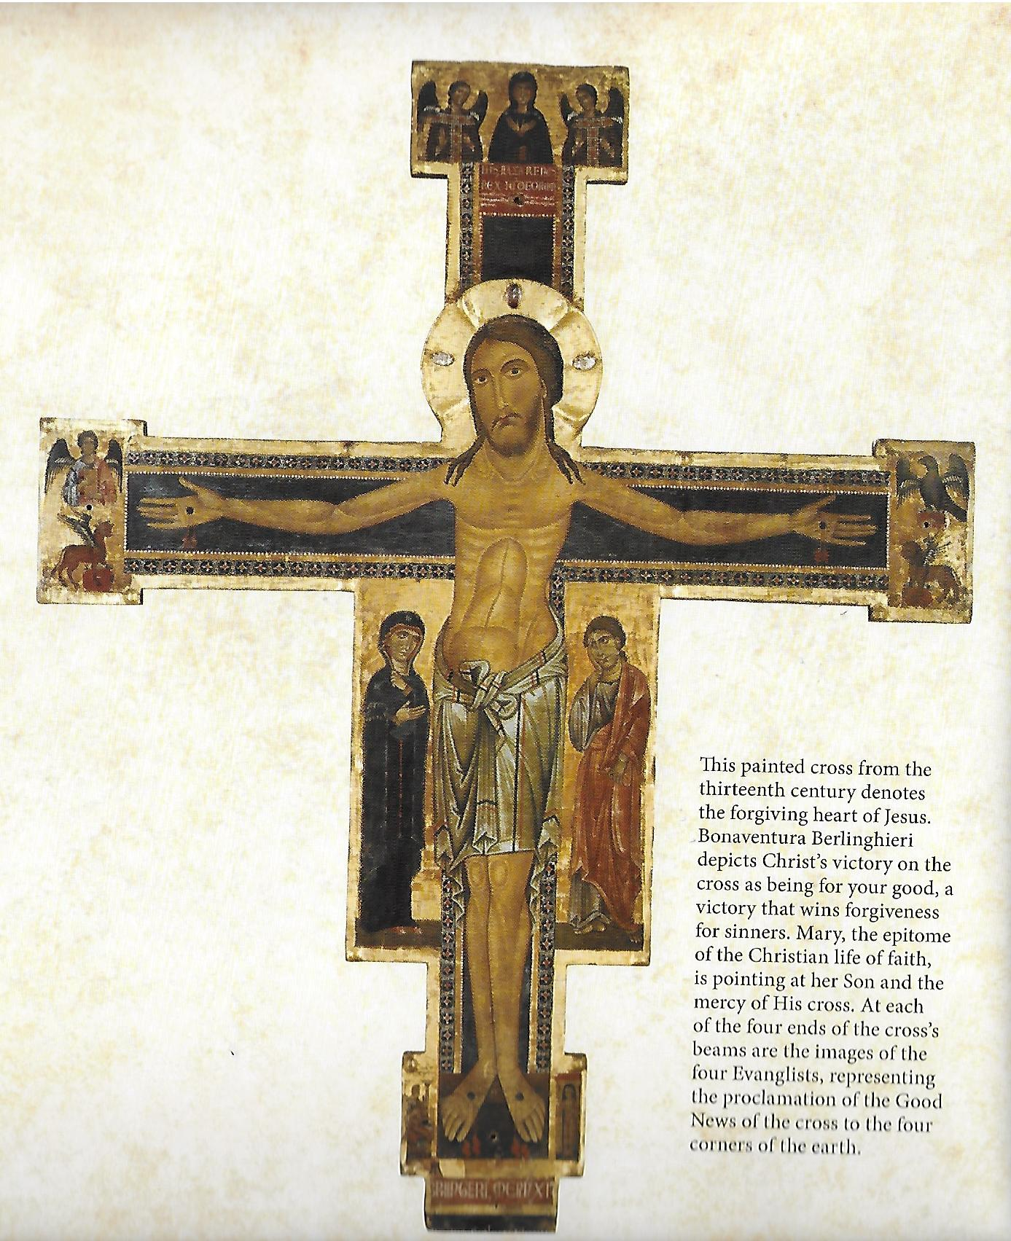

Slide 16
Inscribing the Cosmic Rule and Reign of God

Slide 17
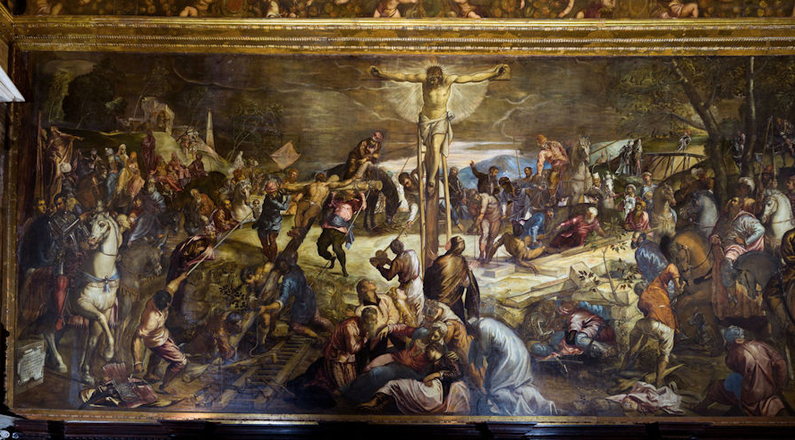

Slide 18
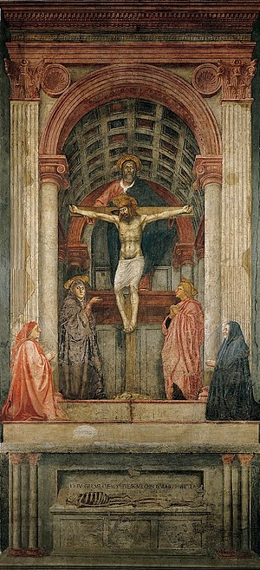

Slide 19
Inscribing the restoration and renewal of creation
the tree of death and life

Slide 20
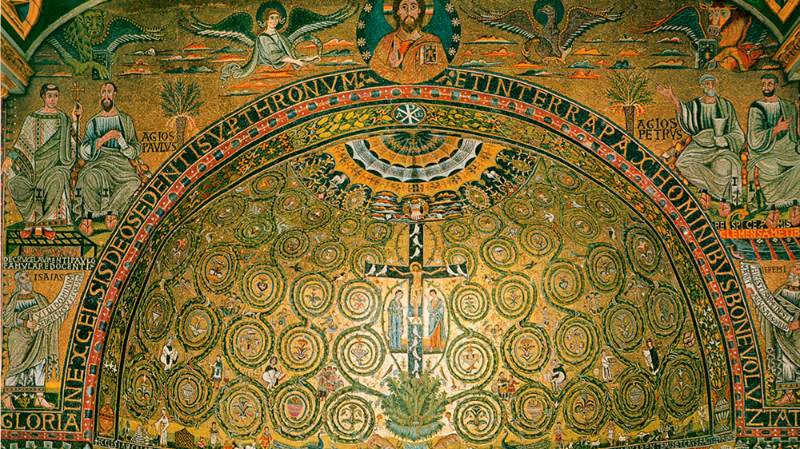

Slide 21
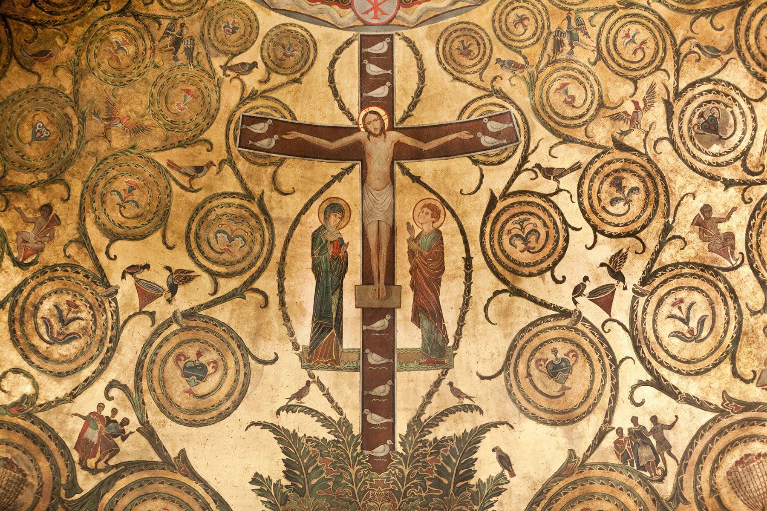

Slide 22
Sing, My Tongue, the Glorious Battle
Faithful cross, true sign of triumph, Be for all the noblest tree; None in foliage, none in blossom, None in fruit thine equal be; Symbol of the world’s redemption, For the weight that hung on thee!

Slide 23
Inscribing the Justification of the rebel human through the word of the cross

Slide 25
Inscribing the scandalous cross

Slide 26
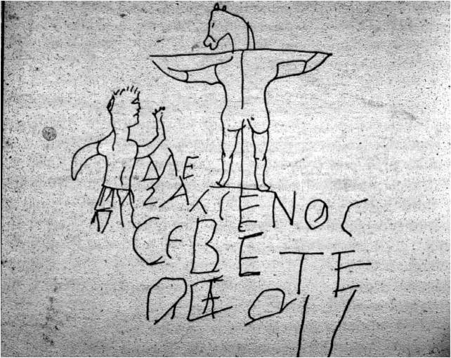

Slide 27
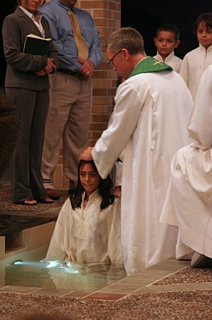

Slide 28
Inscribing the victorious cross
Crux invicta

Slide 29
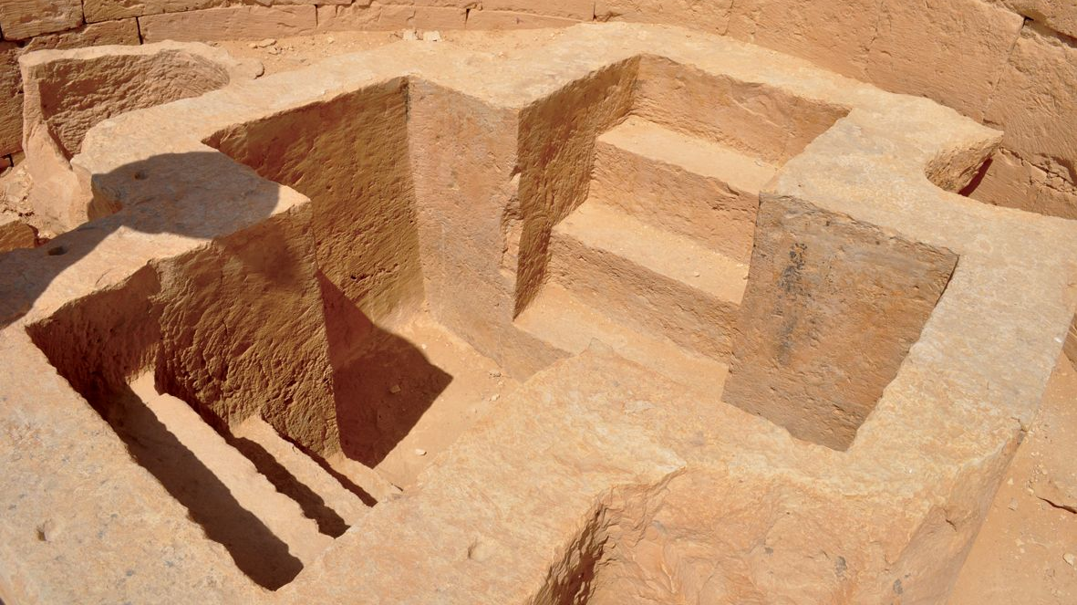

Slide 30
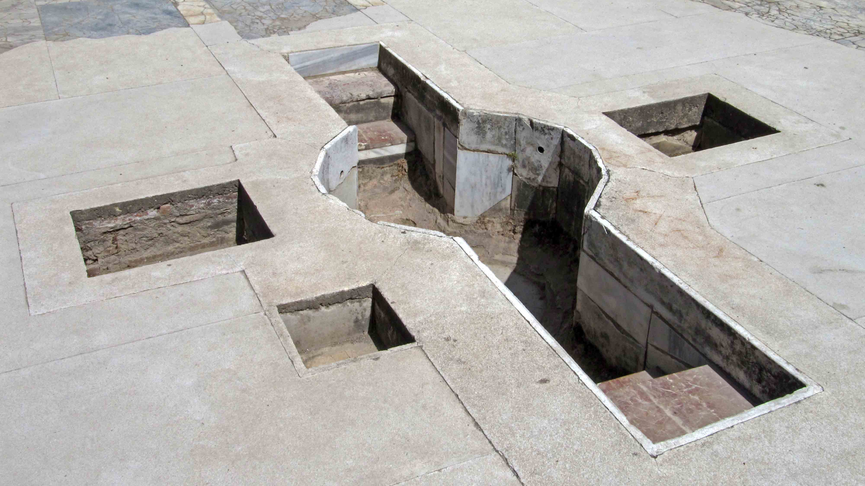

Slide 31
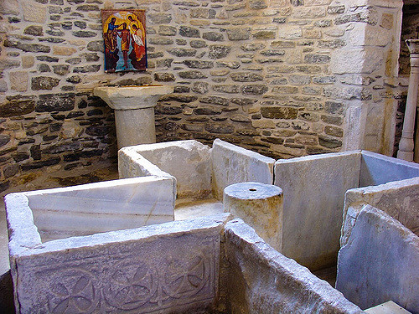

Slide 32
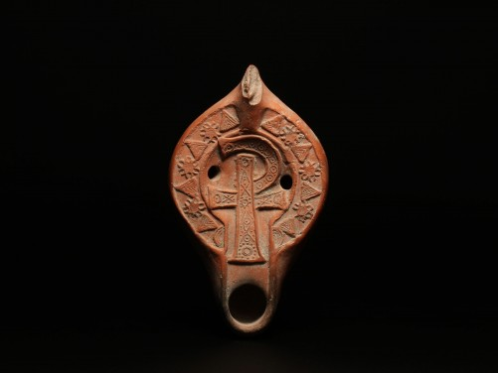
Sample Footer Text
10/8/2018
32

Slide 33
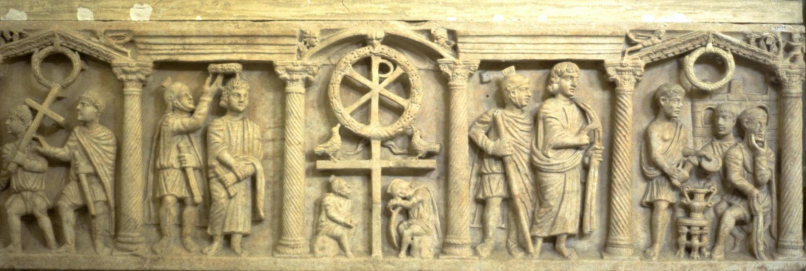
Sample Footer Text
10/8/2018
33

Slide 34
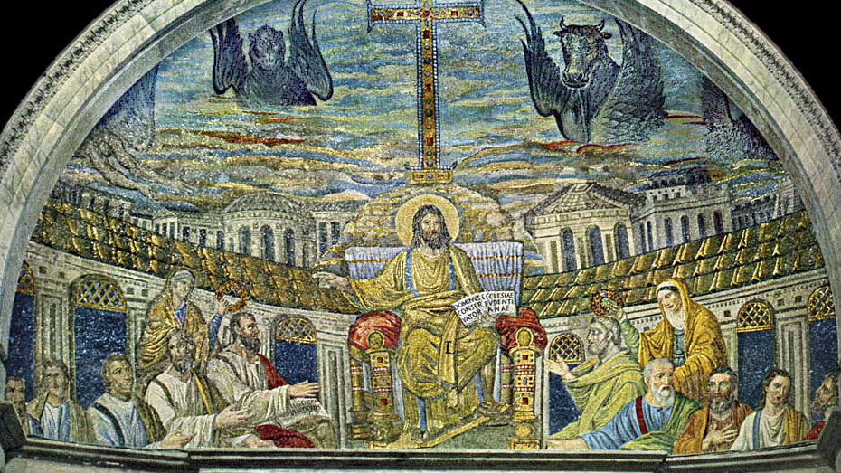

Slide 35
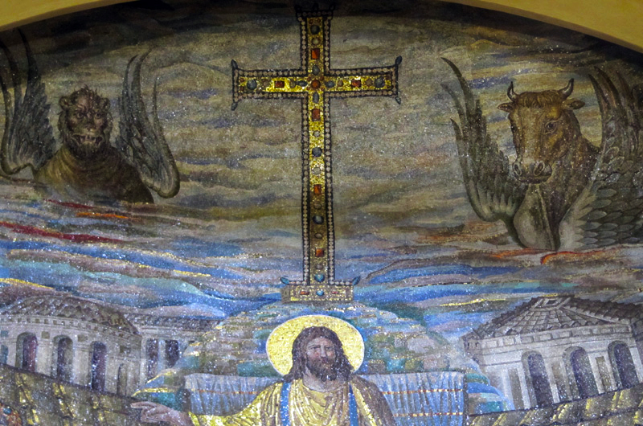
Sample Footer Text
10/8/2018
35

Slide 36
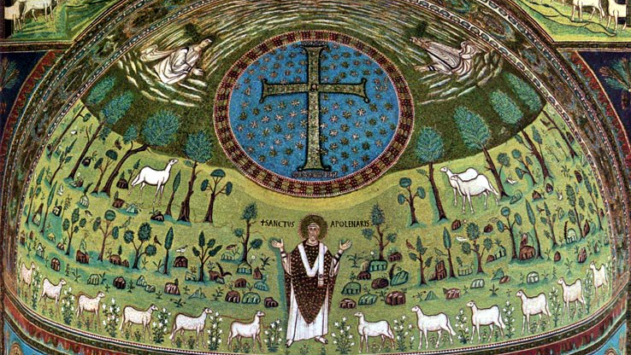

Slide 37
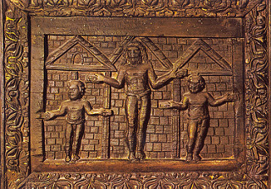

Slide 38
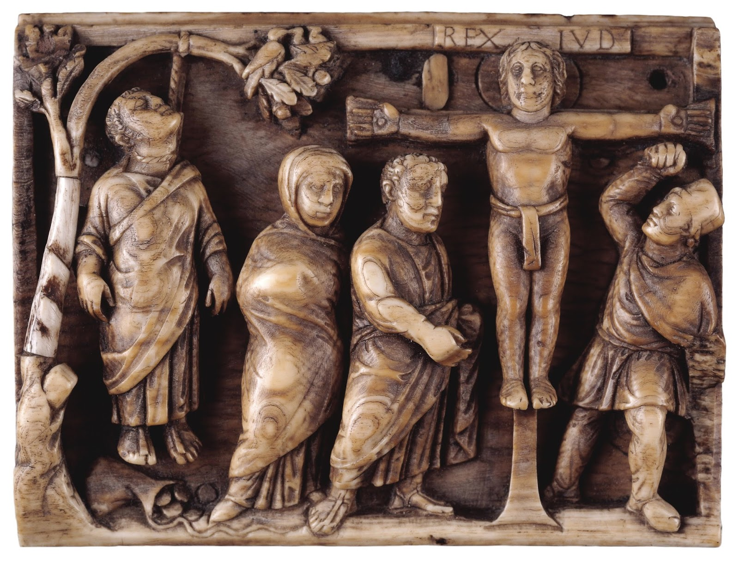

Slide 39
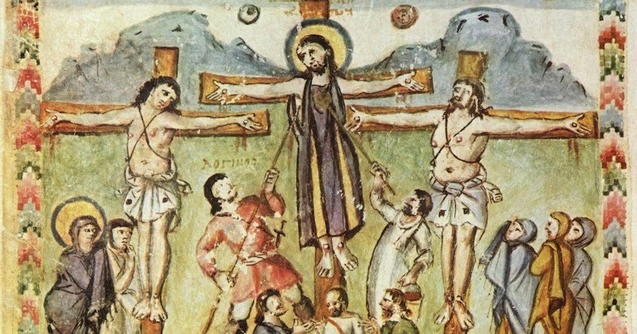

Slide 40
Inscribing the victorious crucifix
the cross as symbolic Remembrance

Slide 41
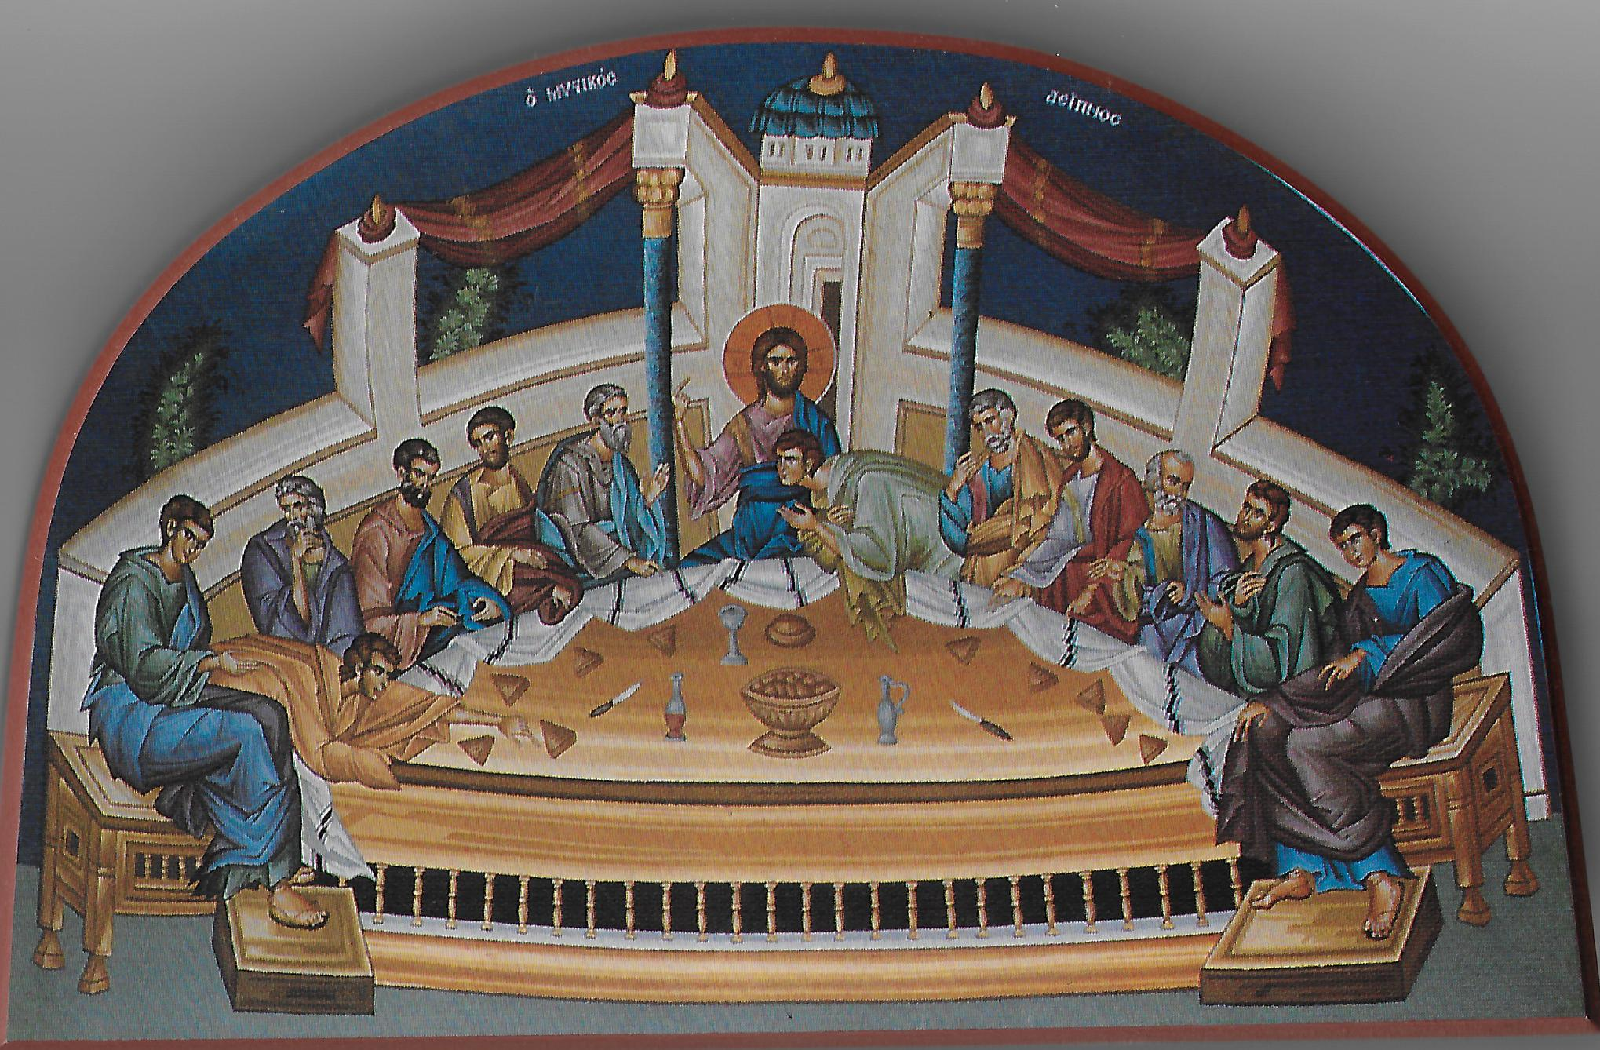
Sample Footer Text
10/8/2018
41

Slide 42
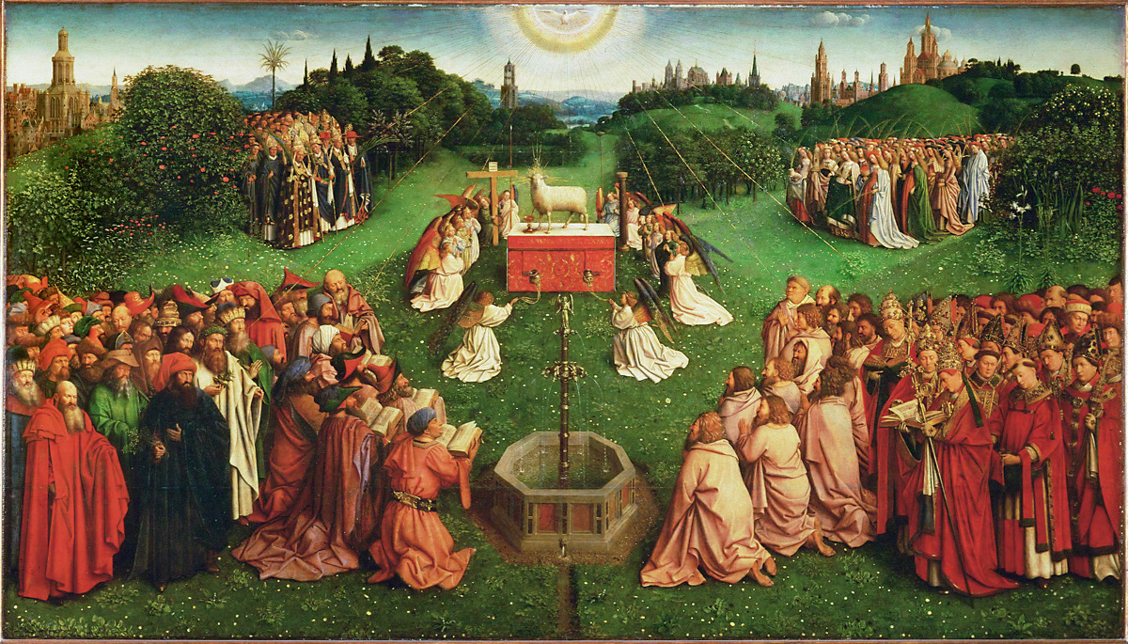

Slide 43
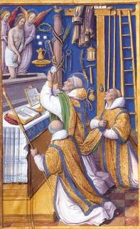

Slide 44
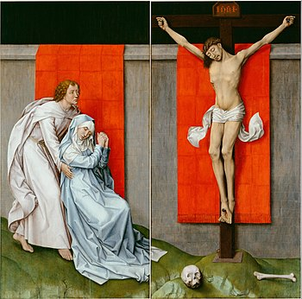

Slide 45
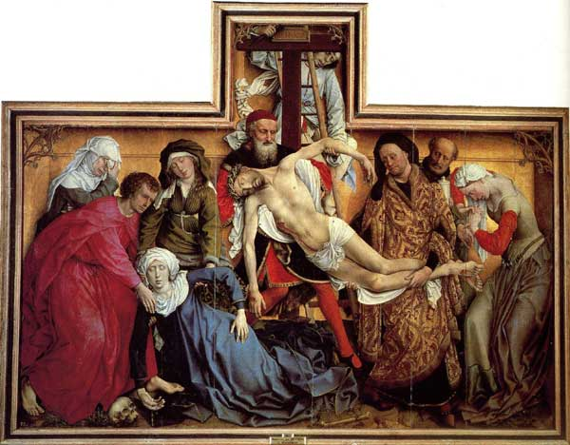

Slide 46
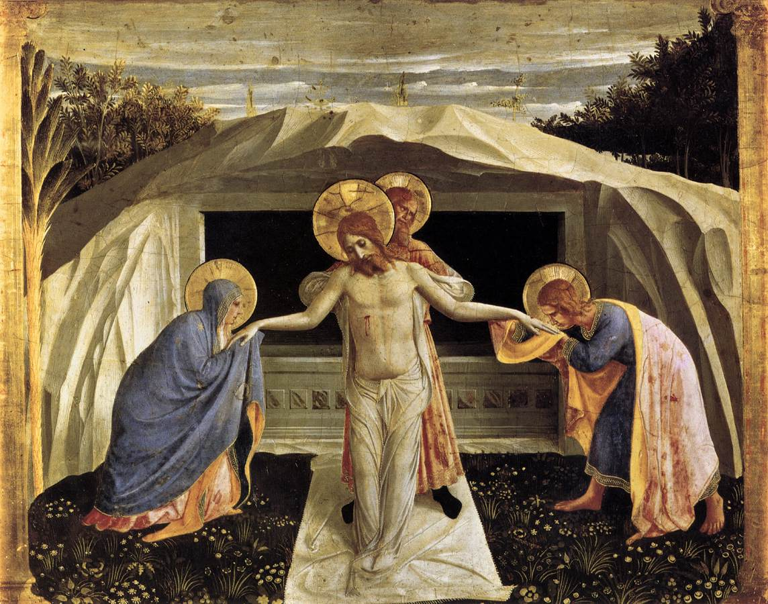

Slide 47
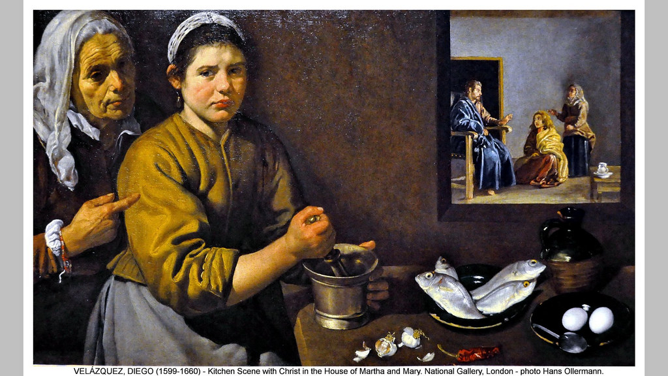

Slide 48
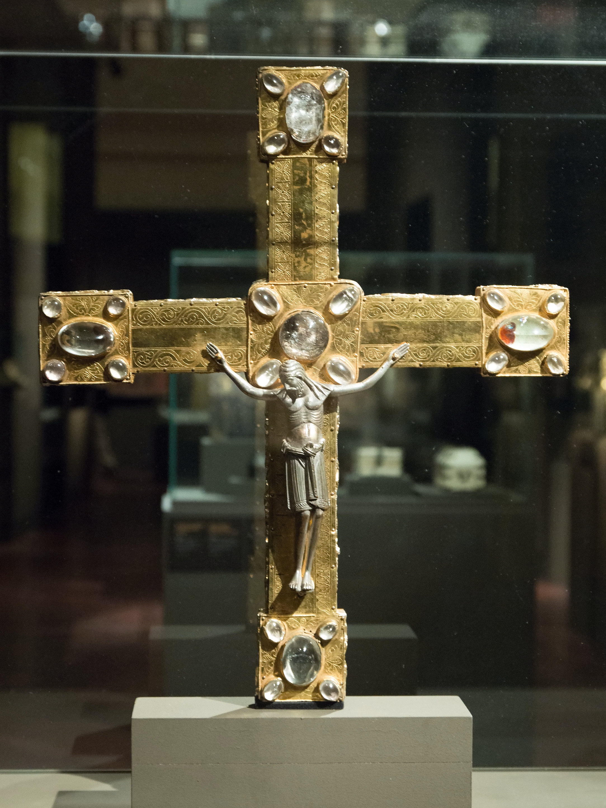

Slide 49
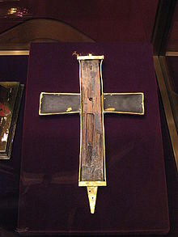

Slide 50
O Sacred Head Now Wounded
O sacred Head, now wounded, With grief and shame weighed down, Now scornfully surrounded With thorns, Thine only crown. O sacred Head, what glory, What bliss, till now was Thine! Yet, though despised and gory, I joy to call Thee mine.

Slide 51
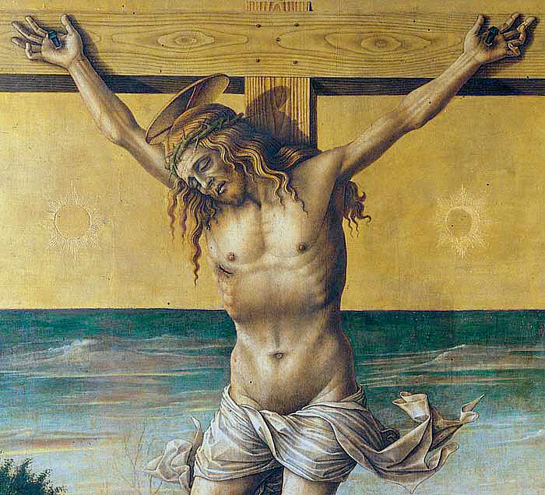
Sample Footer Text
10/8/2018
51

Slide 52
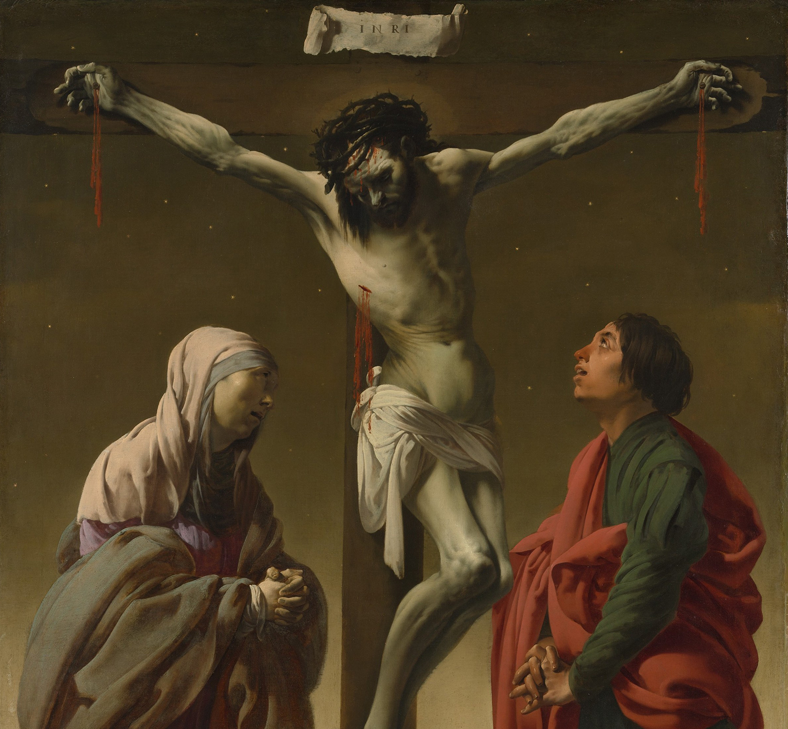

Slide 53
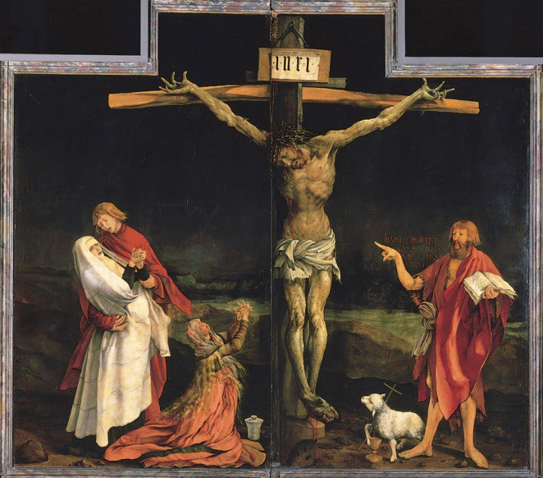
Sample Footer Text
10/8/2018
53

Slide 54
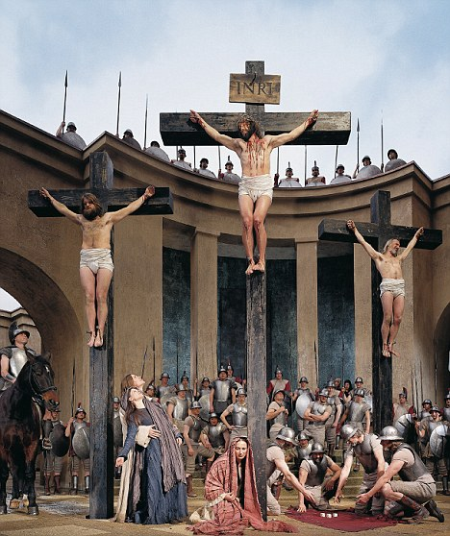

Slide 55
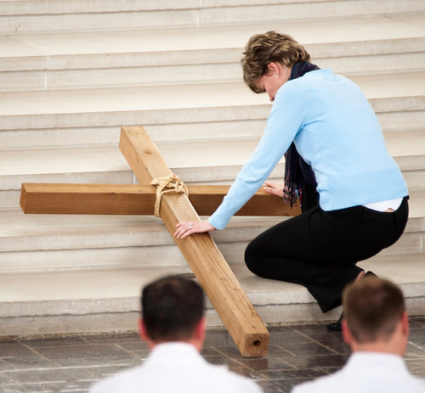

Slide 56
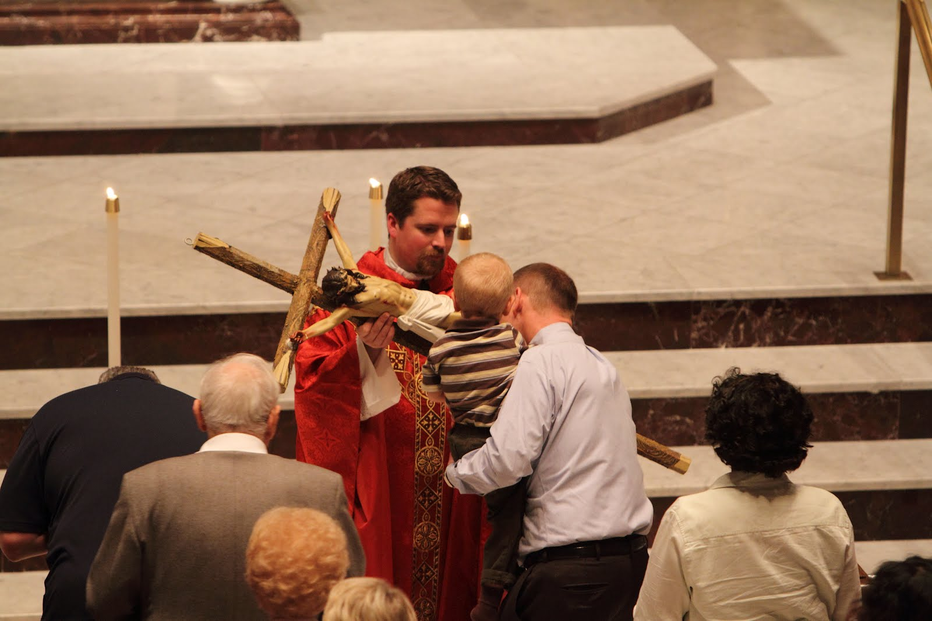

Slide 57
Inscribing the victorious cross (again)
The word of the cross reformation ritual and imagery

Slide 58
Upon the Cross Extended
Your soul in griefs unbounded, Your head with thorns surrounded, You died to ransom me. The cross for me enduring, The crown for me securing, You healed my wounds and set me free.

Slide 59
Christ lag in Todesbanden (BWV 4)

Slide 60
Christ lag in Todesbanden (BWV 4)
Christ lag in Todesbanden Für unsre Sünd gegeben, Er ist wieder erstanden Und hat uns bracht das Leben; Des wir sollen fröhlich sein, Gott loben und ihm dankbar sein Und singen halleluja, Halleluja!
Christ lay in death's bonds given over for our sins, He has risen again and brought us life; therefore we should be joyful, praise God and be thankful to Him and sing Hallelujah, Hallelujah!

Slide 61
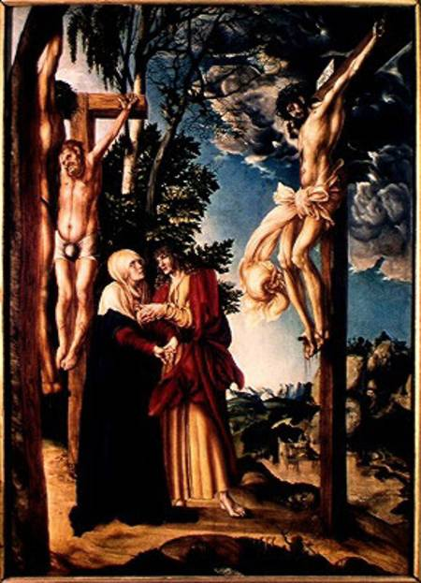

Slide 62
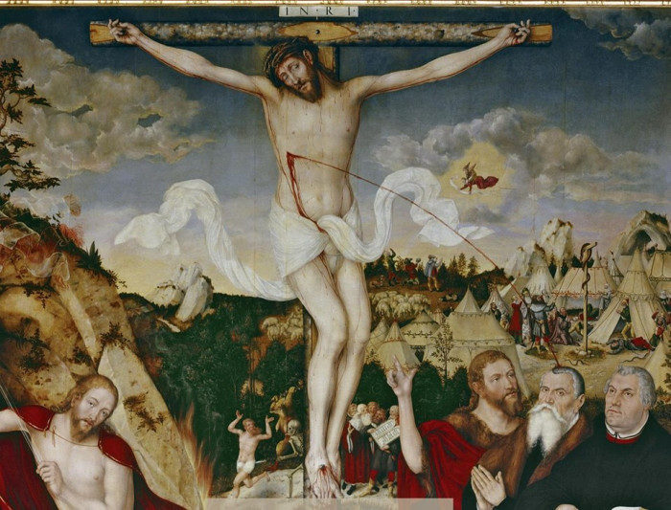

Slide 63
Inculturating the cruciform inscription

Slide 64
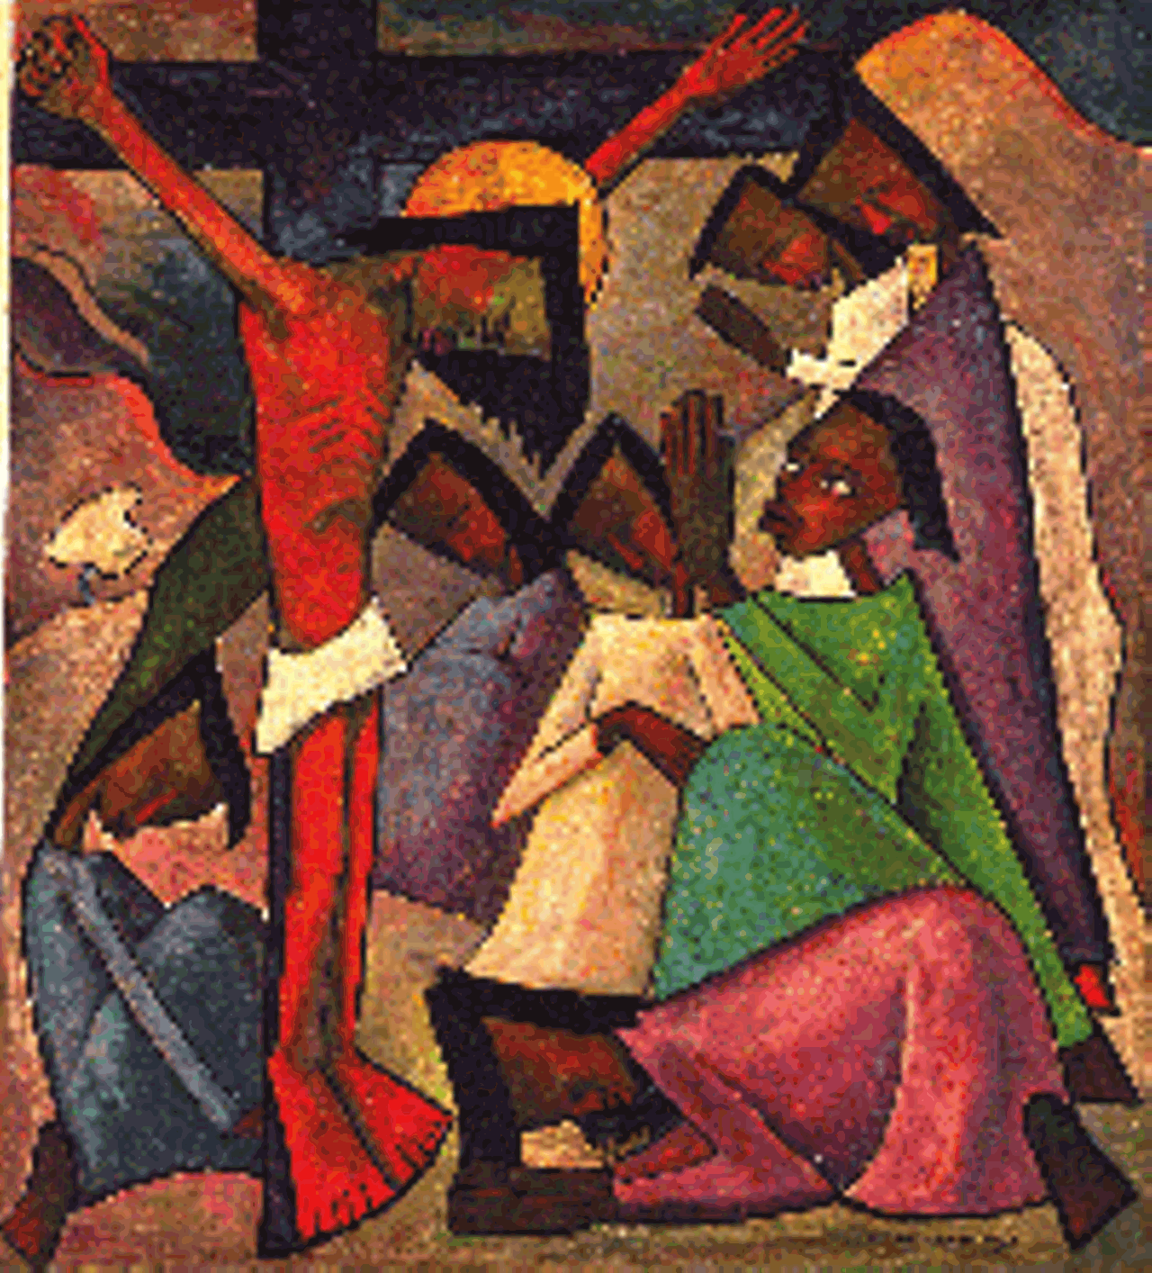

Slide 65
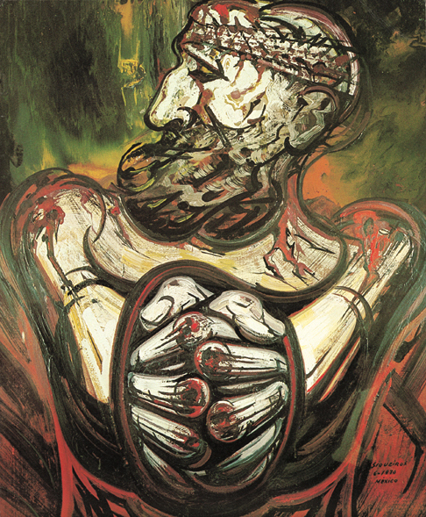

Slide 66
Anointing with oil

Slide 67
