Slide 1
Luke 4:16-30 Third Sunday after Epiphany
Jesus Teaches in the Synagogue at Nazareth

Slide 2
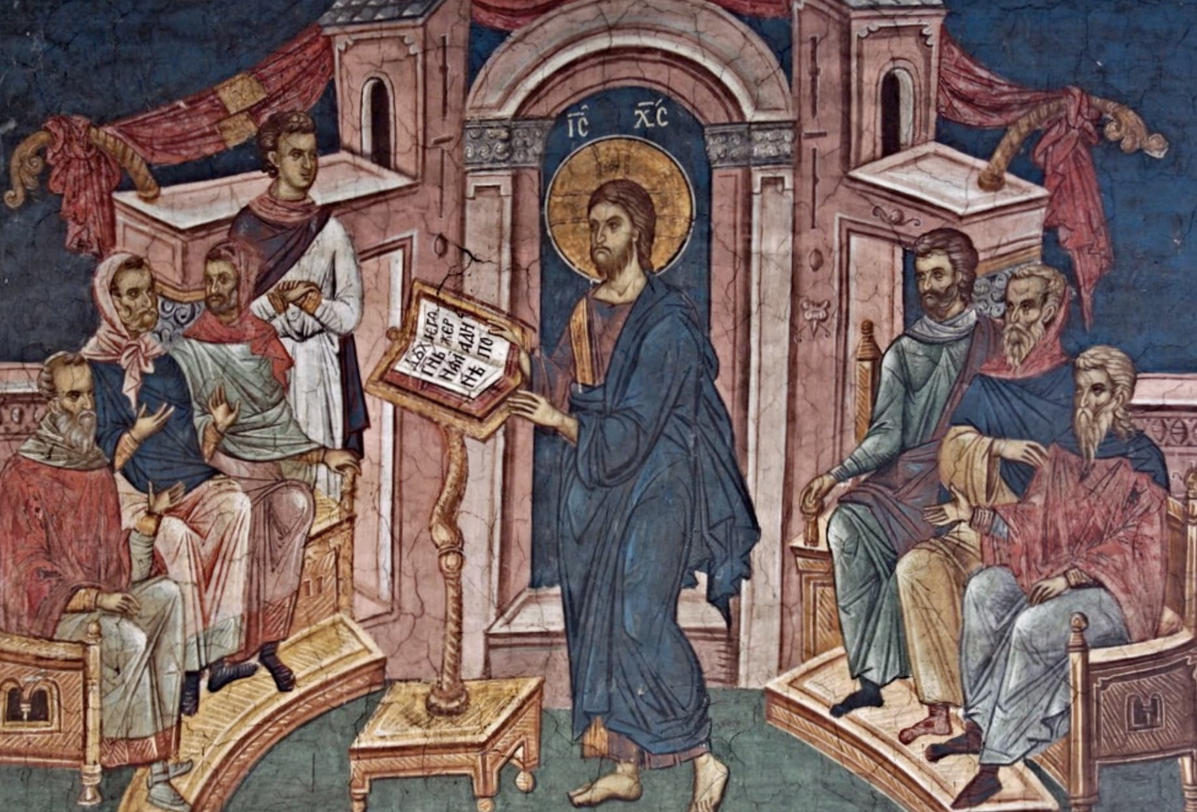
Jesus Teaches in the Synagogue at Nazareth

Slide 3
Assignment: Do This First before You Continue
Read through the Greek of Luke 4:16-22 on your own.
As you read, attempt to identify periphrastic constructions where they appear.
Recall that a periphrastic construction is the combination of a participle with a form of the verb εἰμί (“to be”) where the two forms count together and are parsed as a single verb.
How many periphrastic constructions appear in these verses?

Slide 4
Luke 4:16
Καὶ ἦλθεν¹ εἰς ⸀Ναζαρά,² *
οὗ³ ἦν ⸁τεθραμμένος,⁴
καὶ εἰσῆλθεν¹⸃ κατὰ τὸ εἰωθὸς² °αὐτῷ⁵ ἐν τῇ ἡμέρᾳ² τῶν σαββάτων⁶
εἰς τὴν συναγωγὴν²
καὶ ἀνέστη¹ ἀναγνῶναι.⁷

Slide 5
Luke 4:16 – Vocabulary
τρέφω – verb, here perfect passive participle msn – Active: I rear (a child); Passive: I grow up
εἰωθός – adjective based on obsolete verb and here substantized - custom
ἀνίστημι – verb, here intransitive – I stand up
ἀναγίνωσκω – verb – I read (aloud)

Slide 6
Luke 4:16 – Grammar/Syntax
¹Three indicative mood verbs in three independent clauses. Each verb is aorist indicative active 3rd singular. The wider context indicates that Jesus is the third person subject of each verb.
²Prepositional phrases without the article function as adverbs.
³Relative pronoun. Here it functions as an adverb of place (“where”). The antecedent is Ναζαρά. The clause is adjectival, modifying its antecedent.
⁴Periphrastic construction: An imperfect indicative 3rd person singular form of εἰμι with a perfect passive participle. Together these two verb forms count as a single verb. Here the periphrastic is perfect indicative passive 3rd singular.

Slide 7
Luke 4:16 – Grammar/Syntax
⁵αὐτῷ = Dative of possession. Here the pronoun possesses the substantized adjective εἰωθός.
⁶Genitive – possession.
⁷SOAPER use of infinitive: Purpose, here following a verb of non-motion (ἀνέστη).

Slide 8
Luke 4:17
καὶ ἐπεδόθη¹ αὐτῷ² ⸂βιβλίον³ τοῦ προφήτου Ἠσαΐου⁴ ⸃
καὶ
⸀ἀναπτύξας⁵ τὸ βιβλίον⁶
εὗρεν⁷ °τὸν τόπον⁶
οὗ⁸ ἦν γεγραμμένον·⁹

Slide 9
Luke 4:17 – Vocabulary
ἐπιδίδωμι – verb – I give, I hand over
ἀναπτύσσω – verb, here an aorist participle – I unroll (a scroll)

Slide 10
Luke 4:17 – Grammar/Syntax
¹Aorist indicative passive 3rd singular. How do you know that this is an aorist passive form?
²Dative – indirect object.
³Nominative – subject of the passive voice verb.
⁴Genitive – possession.

Slide 11
Luke 4:17 – Grammar/Syntax
⁵Resolve participle (PREP):
(1) Parse: Aorist participle active msn of ἀναπτύσσω.
(2) ID referent: The subject of εὗρεν (i.e. Jesus).
(3) Establish relative time: Aorist participle is one step back in time
from εὗρεν, so translate as pluperfect.
(4) ID Position: Predicate position, here likely temporal (“after. . .”)

Slide 12
Luke 4:17 – Grammar/Syntax
⁶Accusative – direct object of verb.
⁷Aorist indicative active 3rd singular.
⁸Relative pronoun. Here it functions as an adverb of place (“where”). The antecedent is τόπον. The clause is adjectival, modifying its antecedent.
⁹Periphrastic construction: An imperfect indicative 3rd person singular form of εἰμι with a perfect passive participle. Together these two verb forms count as a single verb. Here the periphrastic is perfect indicative passive 3rd singular.

Slide 13
Luke 4:18-19
πνεῦμα¹ κυρίου² ἐπʼ* ἐμὲ³
οὗ⁴ εἵνεκεν ἔχρισέν⁵ με⁶
εὐαγγελίσασθαι⁷ πτωχοῖς,⁸*
ἀπέσταλκέν ⁵ με,⁶ *⸆
κηρύξαι⁹ αἰχμαλώτοις⁸ ἄφεσιν⁶* καὶ τυφλοῖς⁸ ἀνάβλεψιν,⁶ *
ἀποστεῖλαι⁹ τεθραυσμένους ⁶ ἐν ἀφέσει,³*
κηρύξαι⁹ ἐνιαυτὸν⁶ κυρίου² δεκτόν.¹⁰*

Slide 14
Luke 4:18-19 - Vocabulary
ἕνεκεν – preposition plus genitive where object often precedes the preposition (as here); functions as causal conjunction introducing causal clause – because
χρίω – verb – I anoint
αἰχμάλωτος, ώτου – noun – captive
ἄφεσις, έσεως – noun – release; pardon/forgiveness
ἀνάβλεψις, εως – restoration of sight
θραύω – verb, here substantized passive participle – I oppress
ἐνιαυτός, οῦ – noun – year
δεκτός, ή, όν – adjective – favorable

Slide 15
Luke 4:18-19 – Grammar/Syntax
¹Nominative – subject of the verb. Here there is no verb expressed so assume the verb εἰμι (“to be”).
²Genitive – possession.
³Prepositional phrases without the article function as adverbs.
⁴Genitive form of relative pronoun is object of preposition ἕνεκεν; here relative pronoun functions as regular independent 3rd person pronoun.
⁵Aorist indicative active 3rd person singular.
⁶Accusative – direct object of the verb.

Slide 16
Luke 4:18-19 – Grammar/Syntax
⁷Aorist infinitive middle deponent. SOAPER use of infinitive: Purpose.
⁸Dative – Indirect object.
⁹Aorist infinitive active. SOAPER use of infinitive: Purpose.
¹⁰The referent of the adjective δεκτόν is the noun ἐνιαυτὸν.

Slide 17
Luke 4:20
καὶ
πτύξας¹ τὸ βιβλίον²
ἀποδοὺς³ τῷ ὑπηρέτῃ⁴
ἐκάθισεν·⁵
καὶ πάντων⁶ οἱ ὀφθαλμοὶ ἐν τῇ συναγωγῇ⁷ ἦσαν ἀτενίζοντες⁸ αὐτῷ.⁹*

Slide 18
Luke 4:20 – Vocabulary
πτύσσω – verb, here participle – I fold up (something)
ἀποδίδωμι – verb, here participle – I give back (something to someone)
ὑπηρέτης, ου – noun – helper/assistant
καθίζω – verb – I sit
ἀτενίζω – verb, here participle in periphrastic construction – I look at intently, I stare at

Slide 19
Luke 4:20 – Grammar/Syntax
¹Resolve participle πτύξας (PREP):
(1) Parse: Aorist participle active msn of πτύσσω.
(2) ID referent: The subject of ἐκάθισεν (i.e. Jesus).
(3) Establish relative time: Aorist participle is one step back in time
from ἐκάθισεν, so translate as pluperfect.
(4) ID Position: Predicate position, here likely temporal (“after. . .”)
²Accusative – direct object of verb.

Slide 20
Luke 4:20 – Grammar/Syntax
³Resolve participle ἀποδοὺς (PREP):
(1) Parse: Aorist participle active msn of ἀποδίδωμι.
(2) ID referent: The subject of ἐκάθισεν (i.e. Jesus).
(3) Establish relative time: Aorist participle is one step back in time
from ἐκάθισεν, so translate as pluperfect.
(4) ID Position: Predicate position, here likely temporal (“after. . .”)
⁴Assume βιβλίον is the direct object of the participle ἀποδοὺς. The noun ὑπηρέτῃ is dative of indirect object.
⁵Aorist indicative active 3rd person singular.

Slide 21
Luke 4:20 – Grammar/Syntax
⁶πάντων is substantized adjective. Genitive – possession of οἱ ὀφθαλμοὶ.
⁷Prepositional phrase here is adjectival with the substantized adjective πάντων. The adjective does not have the definite article, and so the prepositional phrase does not need the definite article. “The eyes of all (who were) in the synagogue. . .”
⁸Periphrastic construction: An imperfect indicative 3rd person plural form of εἰμι with a present active participle. Together these two verb forms count as a single verb. Here the periphrastic is imperfect indicative active 3rd plural.

Slide 22
Luke 4:21
ἤρξατο δὲ λέγειν¹ πρὸς αὐτοὺς
°ὅτι σήμερον πεπλήρωται² ἡ γραφὴ αὕτη³ ἐν τοῖς ὠσὶν ὑμῶν.

Slide 23
Luke 4:21 - Vocabulary
σήμερον – adverb – today
οὖς, ὠτός – noun – ear; hearing

Slide 24
Luke 4:21 – Grammar/Syntax
¹ἤρξατο λέγειν: An aorist indicative middle deponent 3rd person singular followed by a present infinitive active. The SOAPER use of the infinitive is direct object of the verb. This construction functions the same as an imperfect form—“He began to say. . .”
²Perfect indicative passive 3rd person singular.
³ἡ γραφὴ αὕτη: Note that the demonstrative pronoun (αὕτη) appears in predicate position to its antecedent, that is, it does not follow the definite article. The nominative case is used here as the subject of the passive verb πεπλήρωται.

Slide 25
Luke 4:22
Καὶ πάντες ἐμαρτύρουν¹ αὐτῷ²
καὶ ἐθαύμαζον¹ ἐπὶ τοῖς λόγοις τῆς χάριτος³
τοῖς ἐκπορευομένοις⁴ ἐκ τοῦ στόματος αὐτοῦ ³
καὶ ἔλεγον¹ ·*
οὐχὶ⁵ υἱός⁶ ἐστιν* Ἰωσὴφ οὗτος;

Slide 26
Luke 4:22 – Vocabulary
μαρτυρέω – verb – I bear witness to – takes the dative case as its direct object
θαυμάζω – verb – I wonder, I marvel, I am astonished
ἐπὶ plus dative – preposition – here BDAG identifies the meaning as “at” following the verb θαυμάζω – “to wonder/marvel at something.”
ἐκπορεύομαι – verb, passive deponent – I go out
στόμα, ατος – noun – mouth

Slide 27
Luke 4:22 – Grammar/Syntax
¹Imperfect indicative active 3rd person plural.
²Dative – direct object of ἐμαρτύρουν.
³Prepositional phrase functions as an adverb.
⁴Resolve participle ἐκπορευομένοις (PREP):
(1) Parse: Present participle passive deponent mpd of ἐκπορεύομαι.
(2) ID referent: τοῖς λόγοις.
(3) Establish relative time: Present participle is same time as
ἐθαύμαζον, so translate as an imperfect.
(4) ID Position: Attributive position, so translate as relative/“who” clause

Slide 28
Luke 4:22 – Grammar/Syntax
⁵οὐχὶ: This negative adverb at the beginning of the question shows that the expected answer is the affirmative/“yes.”
⁶υἱός: Nominative – predicate nominative with a linking verb. The subject of ἐστιν is the demonstrative pronoun οὗτος. Since υἱός precedes the verb ἐστιν it could be definite even without the definite article. This would be an example of Colwell’s rule where a definite noun in predicate position will typically not have the definite article when it comes before the linking verb.

