Slide 1
Luke 17:11-19 Propers 23
Jesus Cleanses 10 Lepers

Slide 2
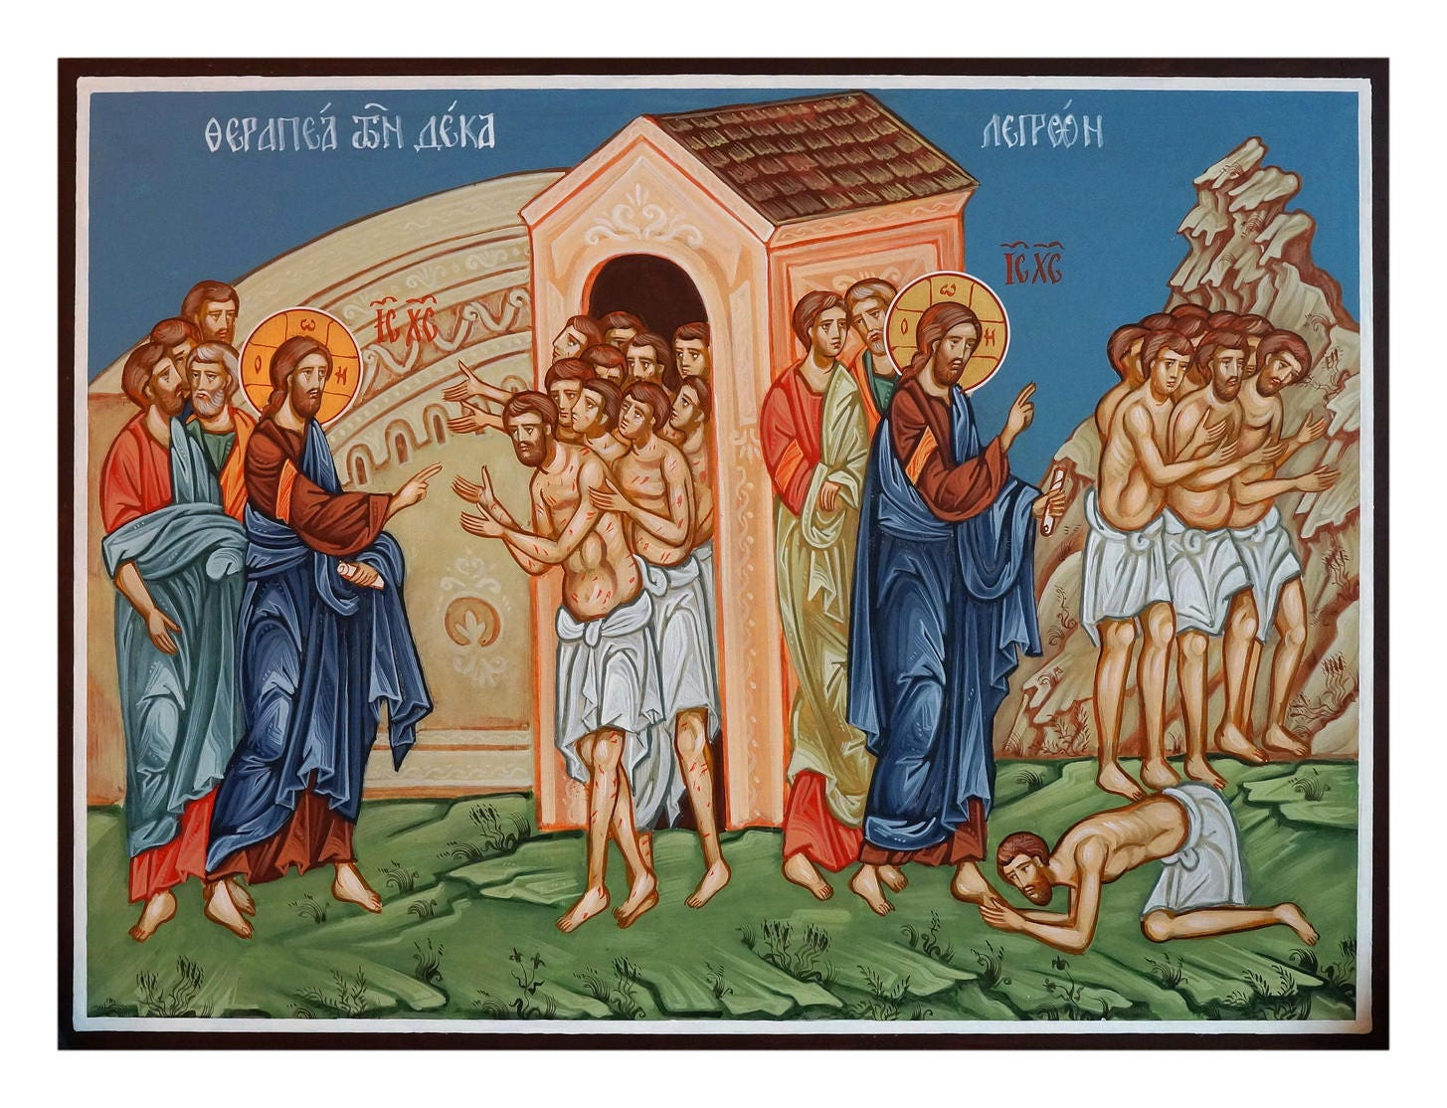
Jesus Cleanses 10 Lepers

Slide 3
Assignment: Do This First before You Continue
Read through the Greek of Luke 17:11-19 on your own.
As you read, make note of any participles that you encounter and consider how these might best be translated.
Do the following for any four of the participles that you encounter:
Parse each participle – identify tense, voice, gender, number, and case.
Identify the referent/subject of each participle – a noun or pronoun in the context that agrees with the participle in gender, number, and case.
Establish the relative time of each participle:
Present participle – action takes place at the same time as the main verb.
Aorist participle – action takes place one step back in time from the main verb.
Identify the position of each participle:
If it has a definite article (“the”), then it is attributive: Translate as a relative clause/who-clause
If it does not have an article, then it is predicate.

Slide 4
Luke 17:11 – Vocabulary
διέρχομαι – verb: I pass through something; I go through
μέσος, η, ον – noun: middle

Slide 5
Luke 17:11 – Travel Notice
¹¹Καὶ ἐγένετο ἐν τῷ πορεύεσθαι* ⸆ εἰς Ἰερουσαλὴμ
καὶ¹ αὐτὸς² διήρχετο ⸂διὰ μέσον⸃ Σαμαρείας καὶ Γαλιλαίας.

Slide 6
Luke 17:11 – Grammar and Syntax
¹ Καὶ ἐγένετο ἐν + infinitive. . .καὶ construction (see FGG, chapter 23).
Reflection of Hebrew grammatical construction as translated in LXX
“And it came to pass. . .that. . .”
² Nominative form of αὐτὸς (see FGG, chapter 40)
Typical used to show emphasis
He or “He himself”

Slide 7
Luke 17:12-13 – Vocabulary
ἀπαντάω – verb: I meet someone (dative case)
πόρρωθεν – adverb: from a distance
ἐπιστάτης, ου, ὁ – noun: master

Slide 8
Luke 17:12-13 – The 10 Lepers’ Request
¹² Καὶ
εἰσερχομένου¹ αὐτοῦ² εἴς τινα κώμην
⸀ἀπήντησαν °[αὐτῷ] δέκα λεπροὶ ἄνδρες,*
⸂οἳ³ ἔστησαν⸃ πόρρωθεν
¹³ καὶ ⸂αὐτοὶ⁴ ἦραν φωνὴν λέγοντες⁵⸃·
Ἰησοῦ ἐπιστάτα⁶, ἐλέησον ἡμᾶς.*

Slide 9
Luke 17:12-13 – Grammar and Syntax
¹ εἰσερχομένου
Parse – present, middle, masculine, singular, genitive
Referent – αὐτοῦ
Relative time – same time as main verb – translate a imperfect
Position – predicate – here introduces temporal clause – “while/as. . .”
² αὐτοῦ - Genitive absolute participle clause
³ Relative pronoun introducing relative clause
⁴ Nominative form of αὐτὸς (see note above)

Slide 10
Luke 17:12-13 – Grammar and Syntax
⁵ λέγοντες
Parse – present, active, masculine, plural, nominative
Referent – λεπροὶ ἄνδρες
Relative time – same time as main verb
Position – predicate – here idiomatic word of speaking – introduces direct discourse
⁶ Vocative used for direct address

Slide 11
Luke 17:14 – Vocabulary
ἐπιδείκνυμι – verb: I show

Slide 12
Luke 17:14 – Jesus Cleanses the Lepers
¹⁴ καὶ
ἰδὼν¹ εἶπεν αὐτοῖς·⸆
πορευθέντες² ἐπιδείξατε ἑαυτοὺς³ τοῖς ἱερεῦσιν.*
καὶ ἐγένετο ἐν τῷ ὑπάγειν αὐτοὺς⁴ ἐκαθαρίσθησαν.

Slide 13
Luke 17:14 – Grammar and Syntax
¹ἰδὼν
Parse – aorist, active, masculine, singular, nominative
Referent – Jesus
Relative time – one step back in time
Position – predicate – here Daniel Wallace’s attendant circumstance
Participle “piggybacks” on the mood of the verb that follows.

Slide 14
Luke 17:14 – Grammar and Syntax
²πορευθέντες
Parse – aorist, passive, masculine, plural, nominative
Referent – Lepers
Relative time – one step back in time
Position – predicate – here Daniel Wallace’s attendant circumstance
Participle “piggybacks” on the mood of the verb that follows.
³ἑαυτοὺς – reflexive pronoun
⁴Καὶ ἐγένετο ἐν + infinitive. . . construction

Slide 15
Luke 17:15-16 – Vocabulary
ἰάομαι – verb: I heal
ὑποστρέφω – verb: I turn back
εὐχαριστέω – verb: I give thanks

Slide 16
Luke 17:15-16 – One Leper Returns to Give Thanks
¹⁵ Εἷς δὲ ἐξ αὐτῶν,
ἰδὼν¹ ὅτι ⸀ἰάθη,*
ὑπέστρεψεν μετὰ φωνῆς μεγάλης δοξάζων² τὸν θεόν,*
¹⁶ καὶ ἔπεσεν ἐπὶ πρόσωπον παρὰ τοὺς πόδας αὐτοῦ εὐχαριστῶν² αὐτῷ·*
καὶ αὐτὸς³ ἦν Σαμαρίτης.

Slide 17
Luke 17:15-16 – Grammar and Syntax
¹ἰδὼν
Parse – aorist, active, masculine, singular, nominative
Referent – Εἷς
Relative time – one step back in time
Position – predicate – here could be temporal or causal
“after he had seen. . .”
“because he had seen. . .”

Slide 18
Luke 17:15-16 – Grammar and Syntax
²δοξάζων/εὐχαριστῶν
Parse – aorist, active, masculine, singular, nominative
Referent – Εἷς
Relative time – one step back in time
Position – predicate – here James Voelz’ attendant circumstance
translate with –ing.
³ Nominative form of αὐτὸς – shows emphasis

Slide 19
Luke 17:17-18 – Vocabulary
ἐννέα – adjective (here substantized): nine
ἀλλογενής, ές – adjective (here substantized): foreigner

Slide 20
Luke 17:17-18 – Jesus’ Comments
¹⁷ἀποκριθεὶς¹ δὲ ὁ Ἰησοῦς εἶπεν·
⸂οὐχὶ² οἱ δέκα⸃ ἐκαθαρίσθησαν;
οἱ °δὲ ἐννέα ποῦ;
¹⁸ ⸂οὐχ² εὑρέθησαν ὑποστρέψαντες³ δοῦναι⸃ δόξαν τῷ θεῷ
εἰ μὴ ὁ ἀλλογενὴς οὗτος;*

Slide 21
Luke 17:17-18 – Grammar and Syntax
¹ἀποκριθεὶς
Parse – aorist, passive, masculine, singular, nominative
Referent – Jesus
Relative time – one step back in time
Position – predicate – here Daniel Wallace’s attendant circumstance
Participle “piggybacks” on the mood of the verb that follows.
²οὐχὶ/οὐχ – Introduce question that expects the answer “yes.”
³ὑποστρέψαντες
Parse – aorist, active, masculine, plural, nominative
Referent – “they” – subject of εὑρέθησαν
Relative time – one step back in time
Position – attributive – translate as who-clause

Slide 22
Luke 17:19 – Jesus Sends and Commends the One Leper
¹⁹ καὶ εἶπεν αὐτῷ·*
ἀναστὰς¹ πορεύου·
⸋ἡ πίστις σου σέσωκέν σε.⸌

Slide 23
Luke 17:12-13 – Grammar and Syntax
¹ἀναστὰς
Parse – aorist, active, masculine, singular, nominative
Referent – the Samaritan
Relative time – one step back in time
Position – predicate – here Daniel Wallace’s attendant circumstance
Participle “piggybacks” on the mood of the verb that follows.

Slide 24
Thoughts on This Text
A main point is that a fitting response to the salvation that Jesus brings is to give thanks and glory to God for this salvation.
And God does take notice of this.
In glorifying God at Jesus’ feet, the author may strongly imply that Jesus is, in fact, divine.
Jesus has the authority to cleanse the unclean apart from the legislation of Leviticus 13-14. He does this for both Jew and non-Jews.

