Slide 1
Luke 23:27-43
Series C:
Gospel Reading for the Last Sunday of the Church Year

Slide 2
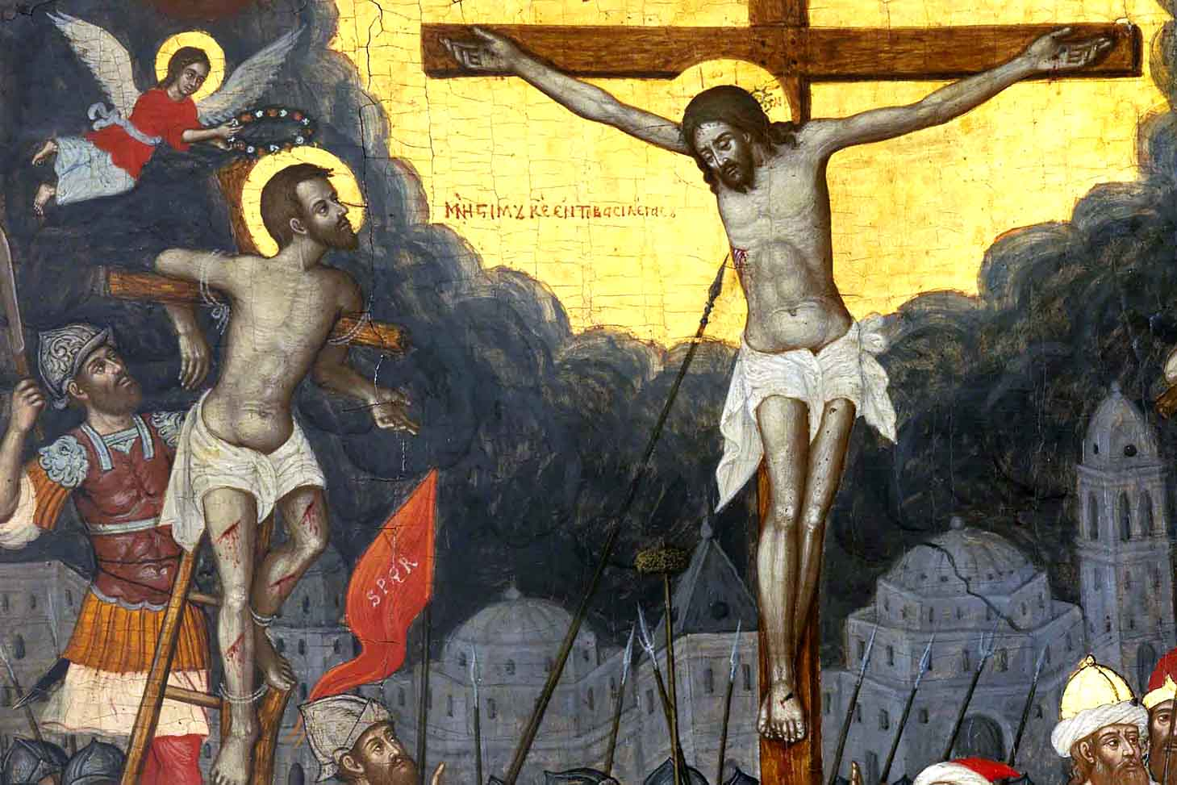
Luke 23:27-43

Slide 3
Assignment: Do This First before You Continue
As you have time, read through the Greek text of Luke 23:27-43. Yet if you do not have time to read the entire passage, focus in particular upon 23:35-43.
As you read, take note of any imperfect tense verbs. See the handout provided to review the possible translations of the imperfect tense (or consult p. 60 of Fundamental Greek Grammar).
As you read, take note of any conditional sentences. See the handout provided to review how to identify conditional sentences (or consult chapter 39 of Fundamental Greek Grammar).

Slide 4
Luke 23:27 – Vocabulary
πλῆθος, ους – crowd of people
κόπτω – middle: I beat my chest as sign of mourning
θρηνέω – I mourn/lament

Slide 5
Luke 23:27
²⁷ Ἠκολούθει¹ δὲ αὐτῷ² πολὺ πλῆθος τοῦ λαοῦ καὶ ⸀γυναικῶν
αἳ³ ἐκόπτοντο ¹ καὶ ἐθρήνουν ¹ αὐτόν.

Slide 6
Luke 23:27 – Grammar and Syntax
¹ Imperfect verbs: What are the best way to translate them here?
² Dative of direct object following ἀκολουθέω
³ Relative pronoun introduces relative clause

Slide 7
Luke 23:28 – Vocabulary
φυγάτηρ, -τερος – daughter
κλαίω – I weep/cry
πλήν – but

Slide 8
Luke 23:28
²⁸ στραφεὶς¹ δὲ ⸂πρὸς αὐτὰς
[ὁ] Ἰησοῦς⸃ εἶπεν·
θυγατέρες² Ἰερουσαλήμ, μὴ κλαίετε³ °ἐπʼ ἐμέ⸆·
πλὴν °ἐφʼ ἑαυτὰς κλαίετε³ καὶ °ἐπὶ τὰ τέκνα ὑμῶν,

Slide 9
Luke 23:28 – Grammar and Syntax
¹ Resolve participle
Parse: Aorist passive masculine singular nominative
Referent: Ἰησοῦς
Position: Predicate – introduces temporal clause
Relative time: Aorist participle is one step back in time from main verb
– introduce with “after”
Note that στρέφω in the passive voice can have an intransitive active meaning, as it does here.
² Vocative case for direct address
³ Present imperative – first use with μή could have sense of “stop crying.”

Slide 10
Luke 23:29 – Vocabulary
ἐρῶ - future of λέγω.
στεῖρα, ας – barren woman
κοιλία, ας – womb/stomach/belly
μαστός, οῦ - breast
ἔθρεψαν is aorist of τρέφω – I feed/nourish

Slide 11
Luke 23:29
²⁹ ὅτι °ἰδοὺ ⸂ἔρχονται ἡμέραι⸃
ἐν αἷς¹ ἐροῦσιν·
μακάριαι αἱ στεῖραι
καὶ αἱ κοιλίαι
αἳ¹ οὐκ ἐγέννησαν
καὶ μαστοὶ
οἳ¹ οὐκ ⸀ἔθρεψαν.

Slide 12
Luke 23:29 – Grammar and Syntax
¹ Relative pronouns introduce relative clauses

Slide 13
Luke 23:30-31 – Vocabulary
βουνός – hill
καλύπτω – I hide
ὑγρός – moist/green
ξύλον – wood/tree
ξηρός - dry

Slide 14
Luke 23:30-31
³⁰ τότε ἄρξονται λέγειν τοῖς ὄρεσιν·
πέσετε ἐφʼ ἡμᾶς,
καὶ τοῖς βουνοῖς·
καλύψατε ἡμᾶς·
³¹ ὅτι εἰ ἐν °τῷ ὑγρῷ ξύλῳ ταῦτα ποιοῦσιν,
ἐν τῷ ξηρῷ τί ⸀γένηται;¹

Slide 15
Luke 23:30-31 – Grammar and Syntax
¹ Mixed conditional sentence:
The if-clause resembles that of a simple particular with εἰ + indicative
But the then-clause has a subjunctive mood verb γένηται.
Note variant reading is future indicative γενήσεται.

Slide 16
Luke 23:32-33 – Vocabulary
κακοῦργος – criminal/evil-doer
ἀναιρέω – I execute/do away with
δεξιός – right
ἀριστερός – left

Slide 17
Luke 23:32-33
³² Ἤγοντο¹ δὲ καὶ ἕτεροι ⸉κακοῦργοι δύο⸊ σὺν αὐτῷ ⸆ ἀναιρεθῆναι.²
³³ Καὶ ὅτε ⸀ἦλθον ἐπὶ τὸν τόπον τὸν καλούμενον Κρανίον,
ἐκεῖ ἐσταύρωσαν αὐτὸν καὶ τοὺς κακούργους ⸆,
ὃν μὲν ἐκ δεξιῶν³
ὃν δὲ ἐξ ἀριστερῶν.³

Slide 18
Luke 23:32-33 – Grammar and Syntax
¹ Imperfect verb: What is the best way to translate it here?
² What is SOAPER use of infinitive? Purpose following verb of motion
³ Two relative clauses that are part of a larger μέν-δέ clause

Slide 19
Luke 23:34 – Vocabulary
διαμερίζω – I divide
κλῆρος – lot

Slide 20
Luke 23:34
³⁴ ⸋⟦ὁ δὲ Ἰησοῦς ἔλεγεν·¹
πάτερ, ἄφες αὐτοῖς, οὐ γὰρ οἴδασιν τί ποιοῦσιν.⟧⸌
⸀διαμεριζόμενοι² δὲ τὰ ἱμάτια αὐτοῦ
⸁ἔβαλον ⸀¹κλήρους.

Slide 21
Luke 23:34 – Textual Criticism
Note the words enclosed in double brackets. This contains the so-called first words of Jesus from the cross. These words are missing in some texts and the double brackets indicate that the editors of Nestle Aland 28 do not believe they are original to the text.
Which texts do not read these and which do? See text critical notes in text or on Logos.
Two earlier witnesses (Papyrus 75 and Vaticanus/B) do not read these words. The original hand of one earlier witness (Aleph/Sinaiticus) does read the words. The second corrector of Aleph apparently deleted these words and then added them back.

Slide 22
Luke 23:32-33 – Grammar and Syntax
¹ Imperfect verb: What is the best way to translate it here?
² Resolve participle
Parse: Present middle (deponent) masculine plural nominative
Referent: Subject of ἔβαλον (“they”)
Position: Predicate – introduces temporal clause
Relative time: Same time as main verb – introduce with “while.”

Slide 23
Luke 23:35 – Vocabulary
ἐκμυκτηρίζω – I ridicule/sneer

Slide 24
Luke 23:35
³⁵ Καὶ εἱστήκει¹ ὁ λαὸς θεωρῶν.²
ἐξεμυκτήριζον³ δὲ ⸂καὶ οἱ ἄρχοντες⸃ λέγοντες·
ἄλλους ⸄ἔσωσεν,
σωσάτω⁴ ἑαυτόν,⁵
εἰ οὗτός ἐστιν ὁ χριστὸς τοῦ θεοῦ⸅ ὁ ἐκλεκτός.⁶

Slide 25
Luke 23:35 – Grammar and Syntax
¹ Pluperfect of ἵστημι functions as imperfect. What is the best way to translate it here?
² Attendant circumstance participle, here following a verb of non-motion (εἱστήκει). Present participle in nominative case and predicate position.
³ Imperfect verb: What is the best way to translate it here?
⁴ Aorist imperative active 3rd person singular
⁵ Reflexive pronoun
⁶ Present simple particular conditional sentence – assume the truth of the if-clause for the sake of the argument.

Slide 26
Luke 23:36-38 – Vocabulary
ἐμπαίζω – I mock/ridicule
ὄξος – sour wine
ἐπιγραφή - inscription

Slide 27
Luke 23:36-38
³⁶ ⸀ἐνέπαιξαν δὲ αὐτῷ καὶ οἱ στρατιῶται
προσερχόμενοι,¹
⸂ὄξος προσφέροντες¹ αὐτῷ⸃
³⁷ ⸂καὶ λέγοντες·¹
εἰ σὺ εἶ⸃ ὁ βασιλεὺς τῶν Ἰουδαίων,
⸄σῶσον σεαυτόν⸅².³
³⁸ ἦν δὲ καὶ ἐπιγραφὴ ⸂ἐπʼ αὐτῷ⸃·
⸄ὁ βασιλεὺς τῶν Ἰουδαίων οὗτος⸅.

Slide 28
Luke 23:36-38 – Grammar and Syntax
¹ Three present participles in predicate position indicating action taking place at the same time as the main verb ἐνέπαιξαν.
² Reflexive pronoun
³ Present simple particular conditional sentence – assume the truth of the if-clause for the sake of the argument.

Slide 29
Luke 23:39 – Vocabulary
κρεμάννυμι – I hang

Slide 30
Luke 23:39
³⁹ Εἷς δὲ τῶν °κρεμασθέντων¹ κακούργων ἐβλασφήμει² αὐτὸν °¹λέγων·
⸋⸀οὐχὶ³ σὺ εἶ ὁ χριστός;
σῶσον σεαυτὸν καὶ ἡμᾶς.⁴⸌

Slide 31
Luke 23:39 – Grammar and Syntax
¹ Resolve participle
Parse: Aorist passive masculine plural genitive
Referent: κακούργων
Position: Attributive – translate as relative clause/who-clause
Relative time: Aorist = one step back in time; translate a pluperfect
² Imperfect tense. What is the best way to translate it here?
³ οὐχὶ introducing question expects the answer “yes,” though here is used sarcastically
⁴ Present simple particular conditional sentence – assume the truth of the if-clause for the sake of the argument.

Slide 32
Luke 23:40-41 – Vocabulary
ἐπιτιμάω – I rebuke
φημί – I say
κρίμα - judgment
ἀπολαμβάνω – I receive
ἄτοπος – wrong

Slide 33
Luke 23:40-41
⁴⁰ ἀποκριθεὶς¹ δὲ ὁ ἕτερος ἐπιτιμῶν² αὐτῷ ἔφη·
οὐδὲ φοβῇ σὺ τὸν θεόν,
ὅτι ἐν τῷ αὐτῷ κρίματι ⸀εἶ;
⁴¹ καὶ ἡμεῖς μὲν³ δικαίως,
ἄξια γὰρ ὧν⁴ ἐπράξαμεν ἀπολαμβάνομεν·
οὗτος δὲ³ οὐδὲν ⸀ἄτοπον ἔπραξεν.

Slide 34
Luke 23:40-41 – Grammar and Syntax
¹ Contemporaneous participle with verb of speech (ἔφη)
² Resolve participle
Parse – Present active masculine singular nominative
Referent – ἕτερος
Position – Predicate: Here likely introduces a temporal clause
Relative time – One step back in time from aorist main verb – introduce with “while/as”
³ μέν-δέ clause
⁴ Relative pronoun introduces relative clause, here sandwiched within main sentence

Slide 35
Luke 23:42-43 – Vocabulary
μιμνῄσκομαι – I remember
σήμερον – today
παράδεισος – paradise/garden of Eden, transcendent place of blessedness

Slide 36
Luke 23:42-43
⁴² καὶ ⸂ἔλεγεν·¹
Ἰησοῦ, μνήσθητί μου ὅταν ἔλθῃς² εἰς τὴν βασιλείαν σου.
⁴³ καὶ εἶπεν αὐτῷ·
ἀμήν σοι λέγω⸃,
σήμερον μετʼ ἐμοῦ ἔσῃ ἐν τῷ παραδείσῳ.

Slide 37
Luke 23:42-43 – Grammar and Syntax
¹ Imperfect verb: What is the best way to translate it here?
² Subjunctive mood of verb used with the conjunction ὅταν indicates some indefinite future action. The criminal believes that Jesus will come in connection with His reign at some future time.

Slide 38
Comments on Text
What is meant by Jesus’ promise to the criminal?
That very day after they both die they will be together with God in the intermediate state in a place of blessedness. The word σήμερον is taken literally. Here Jesus’ promise is about the intermediate state.
Jesus is talking about some future day, likely post-resurrection, when they will be together in a place of blessedness, yet this day is coming so soon that for the criminal it will seem like “today.” The word σήμερον is taken nonliterally. Here Jesus’ promise is about the resurrection and life in the New Heavens and New Earth.
Why is this text used on the Last Sunday of the Church Year in Series C? Are we to be directed to the intermediate state as the promise we await or the resurrection on the Last Day?

